Slide 1
LEARN THIS NOW: There are only a few ways to connect neurons. Here are the major ways to do it, with example functions.
1:1 (relay)
exception is auditory system…
Many:1 (IN SENSORY SYSTEMS – GAIN,
IN PERCETUAL SYSTEMS – COMPLEXITY)
1:Many (arousal)

Slide 2
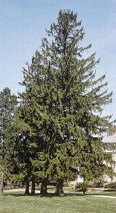
Don’t You Just Love Neurons?
Why doesn’t this creature have any neurons?
Neurons are cells specialized for long-distance, rapid communication.
Yes/No signals carried within neurons are electrical (Action Potentials)
Yes/No signals passed between neurons are chemical (Neurotransmitters)

Slide 3
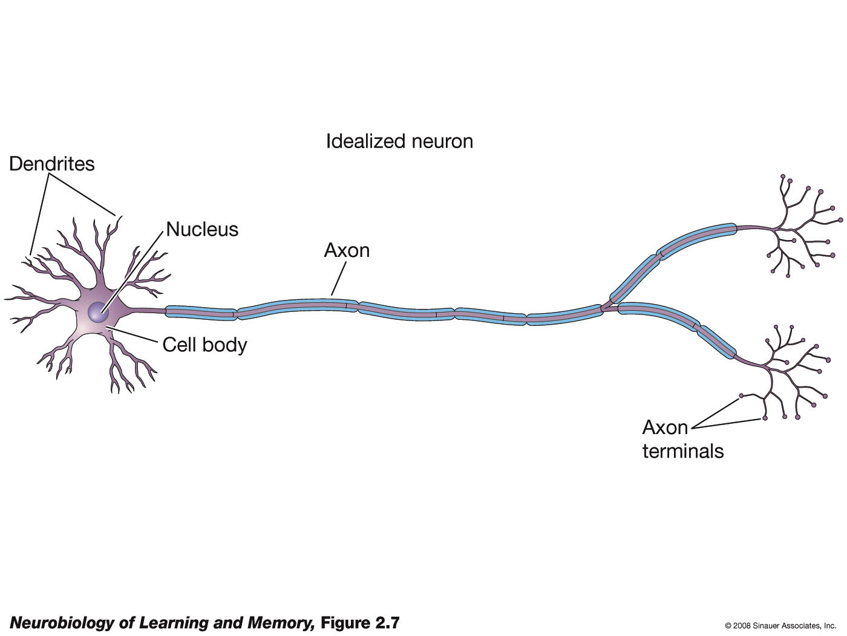
There are TWO general TYPES of neurons, as defined by the type of neurotransmitter they release.
Excitatory
‘Offense’
‘YES’
(example is
GLUTAMATE)
Inhibitory
‘Defense’
‘NO’
(example is GABA)

Slide 4
A 2D Sheet of Sensory Neurons
(Yes/No Responses)
In this silly example: these are ALL ‘excitatory’ neurons

Slide 5
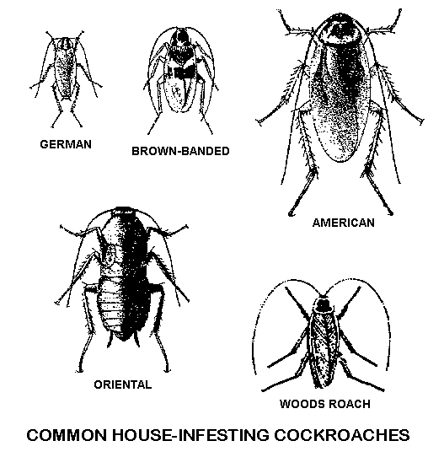
Don’t You Just Love Neurons?
Why are these guys so small (uh… generally)?
Neurons needed a little help before they could move big ol’ me and you around
To love neurons is to know GLIAL cells

Slide 6
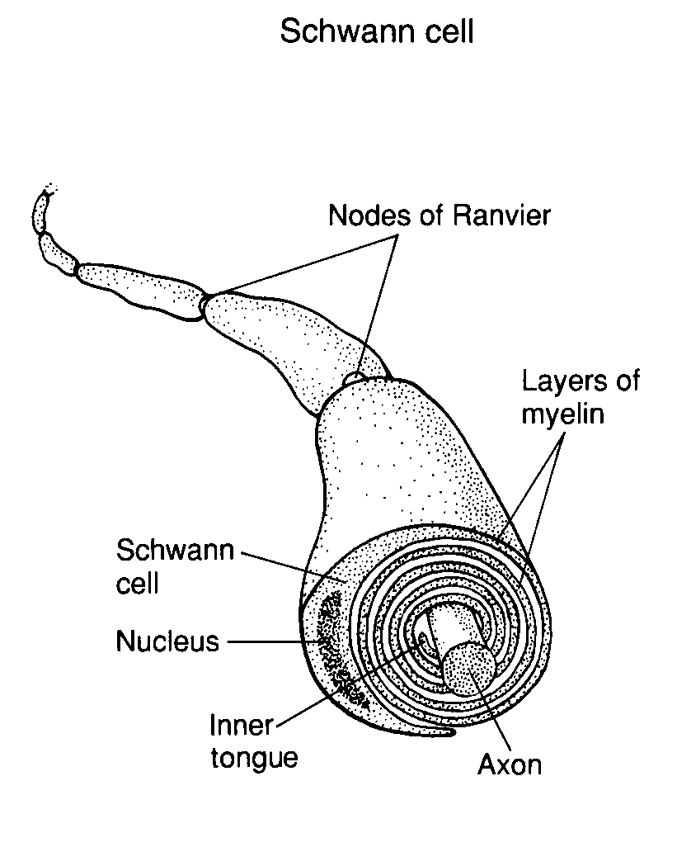
Myelin
It’s good for your
brain to be a little
‘chubby’
Fatty glial cells that wrap themselves around axons
Creates ‘insulation’ - idea is to increase the speed of the neural impulse
Allows increase in body size and a centralized brain

Slide 7
Ohm’s Law
V = IR
Voltage = Current x Resistance
The Amount
of Push
=
The Amount
of Flow
x
The Amount of Resistance to the Flow
Note that the ‘amount of push’ (voltage) will influence how far an electrical signal (current) can be transmitted.
Neurons operate at tiny voltages (think way, way less than a AAA battery) so you know already that they have tiny currents and low resistances.
How can they send electrical signals from one end of your body to the other? They must have a trick up their sleeve!

Slide 8
Isn’t It Ionic?
K⁺
Cl⁻
Ca⁺⁺
Na⁺
Electrical Activity in Neurons is IONIC.
An ION is an atom having fewer/more electrons than protons.
Thus, ions have electrical charge (+/-).
However, regardless of their charge, they are also subject to entropy, like any other atom.
That is, they will move from areas of high concentration to areas of low concentration (but, this requires that they be in a solution, like water).
The direction of ELECTRICAL and CONCENTRATION GRADIENTS determines ion movement.

Slide 9
Neurons Use Ions To Create Three Kinds of Potentials (i.e., Voltages)
Resting, Synaptic, Action

Slide 10
Voltage - A Charge Difference Across The Neuron’s Membrane
Like ‘water pressure’ in plumbing
Drives electrical current flow (ions)
Some handy voltages to know:
  Lightning, ~billion volts
  Wall Outlet, 120 volts
  Car Battery, 12 volts
  AAA Battery, 1.5 volts
  resting neuron, 0.070 volts
Wow!

Slide 11
Neurons can run at low voltages because action potentials are regenerative
The drawback is that regenerating electrical signals takes time
Big
Voltage
Resting, Synaptic, Action

Slide 12
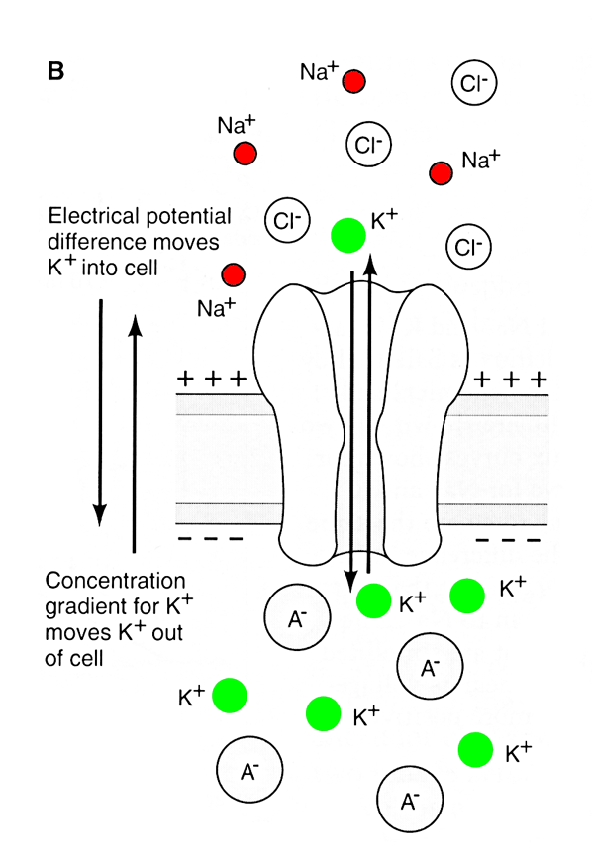
Meet The Potentials - Resting
Dynamic Equilibrium:
In layman’s terms, speedy thing goes in as speedy thing comes out. Repeat.
Neurons use ‘ION Channels’, which sit in the cell membrane, to control the entry/exit of IONS
e
c
e
c
The voltage across
the membrane is
about -70 mV
Channel | State
K+ | Open
Na+ | Closed
Cl- | Closed
Ca++ | Closed

Slide 13
The Resting Potential
This is our ‘baseline’ state
positive
outside
e
c
e
c
e
c
Na+
closed
K+
open
K+
Cl-
closed
negative
inside
A-
A-
A-
A-
Channel | State
K+ | Open
Na+ | Closed
Cl- | Closed
Ca++ | Closed

Slide 14
What Happens When We Open Na+ Channels?
negative
outside
e
c
e
c
e
c
Na+
K+
Cl-
Na+
K+
positive
inside
A-
A-
A-
A-
Channel | State
K+ | Open
Na+ | Open
Cl- | Closed
Ca++ | Closed

Slide 15
OVERVIEW: A simple 3-step process…
At rest, neurons possess a tiny negative voltage (-70 mV), Resting Potential.
1. Chemical Signals Received
3. Chemical Signals Released
On DENDRITES, neurotransmitters open ion channels to produce small positive or negative changes in voltage, Synaptic Potentials.
2. Electrical Signal Sent
Positive Synaptic Potentials open ion channels in the AXON to produce a self-propagating reversal of the cell’s voltage (-70 / +30 / -70 mV), Action Potentials.
Information flows in only ONE direction.

Slide 16

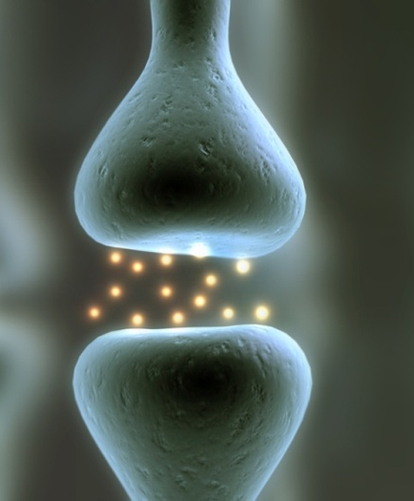

Synaptic Potentials Are
Of TWO General Types
Example
Channel | State
K+ | Open
Na+ | Open
Cl- | Closed
Ca++ | Closed
Excitatory
Positive
‘YES’
-60 mV
(Resting) -70 mV
time
Example
Channel | State
K+ | Open
Na+ | Closed
Cl- | Open
Ca++ | Closed
Inhibitory
Negative
‘NO’
-60 mV
(Resting) -70 mV
time

Slide 17
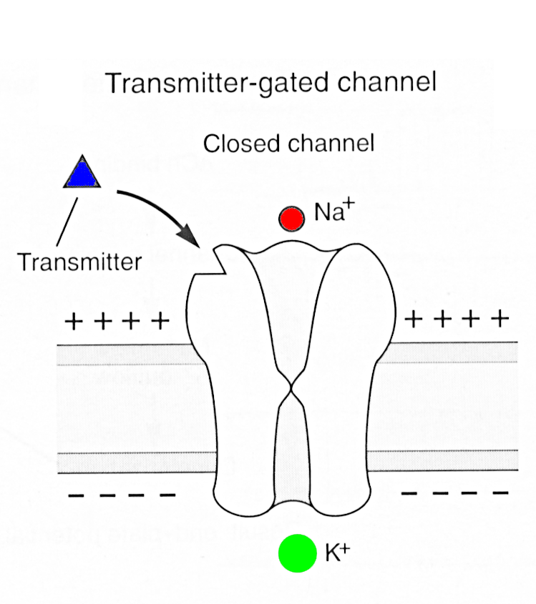
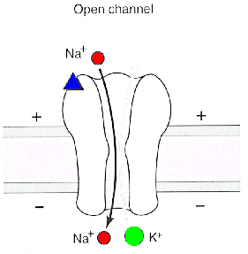
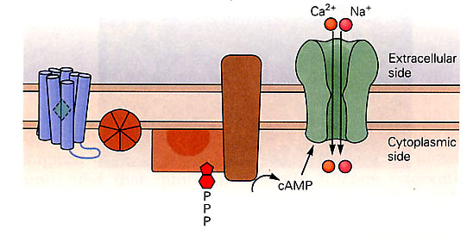
Meet The Potentials
- Synaptic
There are TWO general classes of receptors: Ionotropic and Metabotropic.
The receptor at right is an Ionotropic receptor. Metabotropic receptors utilize a ‘second messenger’ to open the ion channel (see example below).

Slide 18
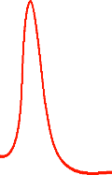
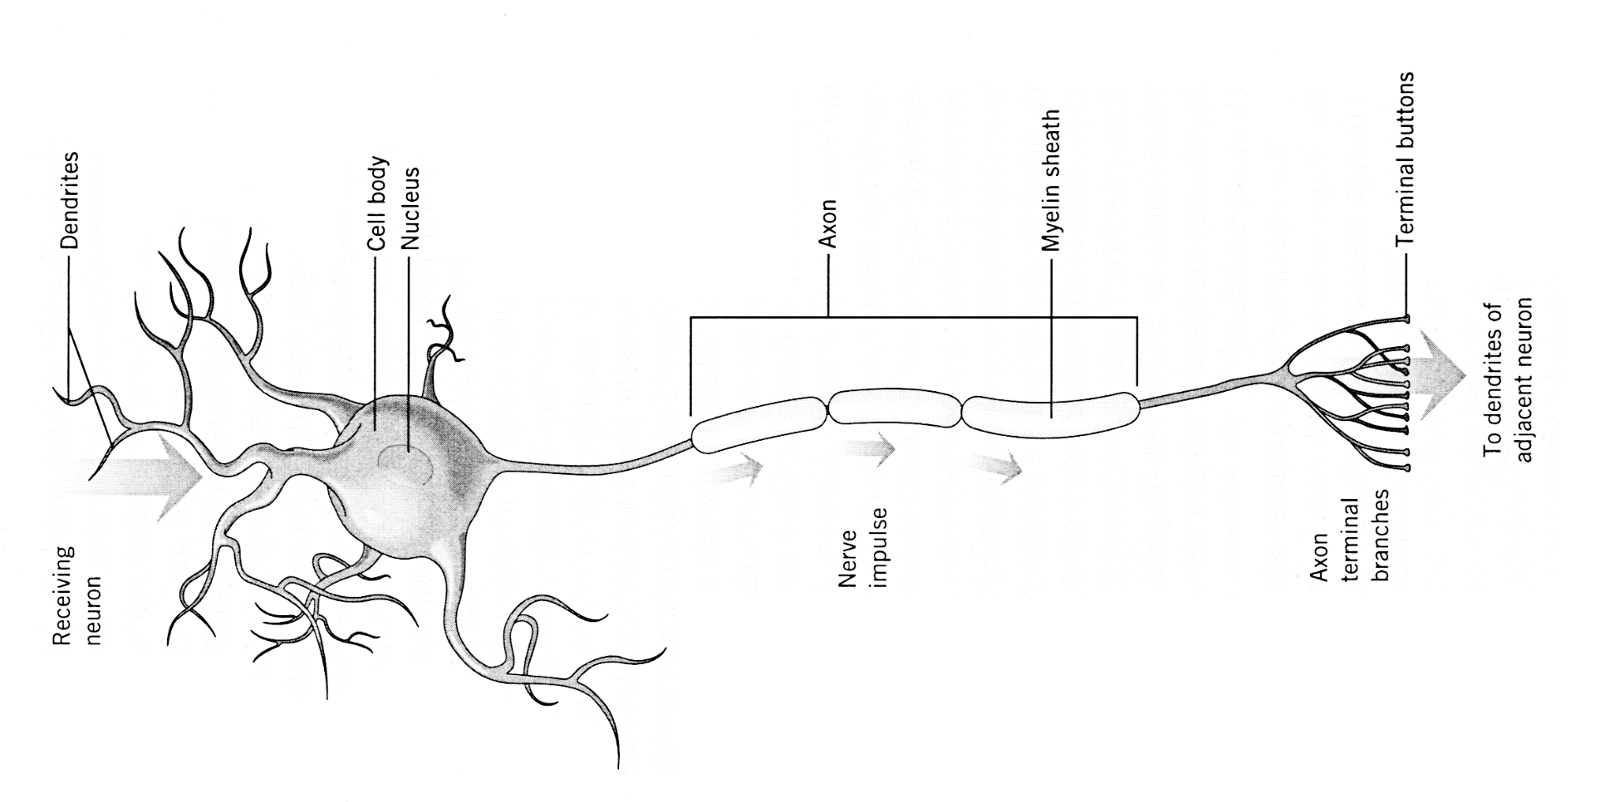
Transmitter-gated channels
Na+ in, additive
Voltage-gated channels
Na+ in, K+ out, regenerative
-50 mV
+30 mV
-70 mV
-50 mV
-70 mV
Resting, Synaptic, Action

Slide 19



Transmitter-gated channels
Na⁺ in, additive
Voltage-gated channels
Na⁺ in, K+ out, regenerative
-50 mV
+30 mV
If neurons were human devices, we’d use a big ol’ voltage to push the current all the way down the axon in one step
-70 mV
-50 mV
-70 mV
Resting, Synaptic, Action

Slide 20

Transmitter-gated channels
Na⁺ in, additive
Voltage-gated channels
Na⁺ in, K+ out, regenerative
-50 mV
+30 mV
-70 mV
-50 mV
-70 mV
Nature’s approach is to use a series of tiny voltages (action potentials) to push the current in a series of small steps.
Resting, Synaptic, Action

Slide 21

Transmitter-gated channels
Na+, Cl- in, additive
-50 mV
-70 mV
Resting, Synaptic, Action

Slide 22
Meet The Potentials:
Action Potentials!
+30 mV
-70 mV
At Rest
Peak of AP
Back to Rest
K⁺ Na⁺
K⁺ Na⁺
K⁺ Na⁺
OUT
e
c
e
c
e
c
e
c
e
c
e
c
IN

Slide 23

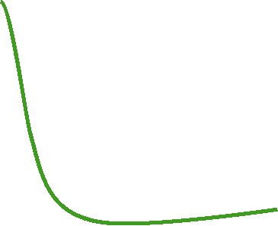
Approaches
Equilibrium
for Na⁺
Rising Phase of AP
+30 mV
Channel | State
K+ | Open
Na+ | Open
Cl- | Closed
Ca++ | Closed
-50 mV
Back to
Equilibrium
for K+
-70 mV
Falling Phase of AP
0 1 2 3 4 msec
Channel | State
K+ | More Channels Open
Na+ | Closed
Cl- | Closed
Ca++ | Closed
Voltage-Gated Na⁺ Channels
IN AXONS
All-Or-None: Voltage Opens, Time Closes
Refractory Period

Slide 24
+30 mV
The
Action
Potential
-70 mV
0 1 2 3 4 msec
1. Rising Phase: Na⁺ Entry
2. Falling Phase: K⁺ Exit
3. The Na+/K+ pump restores ion concentrations

Slide 25
The
Action
Potential
A Chain Reaction Down The Axon
+ + + + +
+ + + + +
+ + + + +

Slide 26
The
Action
Potential
A Chain Reaction Down The Axon
+ + + + +
+ + + + +
+ + + + +

Slide 27

Action Potentials in an Unmyelinated Axon

Slide 28
Action Potentials in an Myelinated Axon

Slide 29
Release the Hounds!
. . .uh, I mean neurotransmitter
Ca++

Slide 30
Ca++
Ca++
Calcium is Necessary and Sufficient
for Neurotransmitter Release
Ca++
. . .zzzzzzz

Slide 31
Normal
Agonist
Antagonist
. . .zzzzzzz

Slide 32
Transmitter-gated channels
Na⁺, Cl⁻ in, additive
There are also agonist and antagonist drugs for ‘inhibitory’ neurotransmitters
-50 mV
-70 mV
Resting, Synaptic, Action

Slide 33
Transmitter-gated channels
Na⁺, Cl⁻ in, additive
There are also agonist and antagonist drugs for ‘inhibitory’ neurotransmitters
-50 mV
-70 mV
Resting, Synaptic, Action

Slide 34


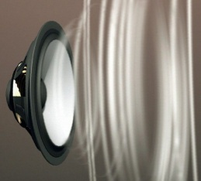
Voltage-gated channels
Na⁺ in, K+ out, regenerative
STIMULUS-gated channels
-50 mV
+30 mV
-70 mV
-50 mV
-70 mV
In Sensory Receptor Neurons, synaptic potentials are called ‘generator potentials’!
They are triggered by STIMULI (energy or matter) instead of neurotransmitters.

