Slide 1
EYE AND RETINA
What is light? Where does it fit into the spectrum of electromagnetic radiation?
Why is short wavelength electromagnetic radiation dangerous to us, whereas long wavelength electromagnetic radiation is considered ‘safe’?
Which wavelengths do we see as ‘Light’? Why these wavelengths? Why couldn’t the shorter and longer wavelength stuff work just as well?
Given the properties of Light, what has to be different about the sensory system that detects it? Which properties of Light are related to Hue (color) and Brightness?
Photoreceptors: Functional differences between rods and cones (thresholds!)

Slide 2
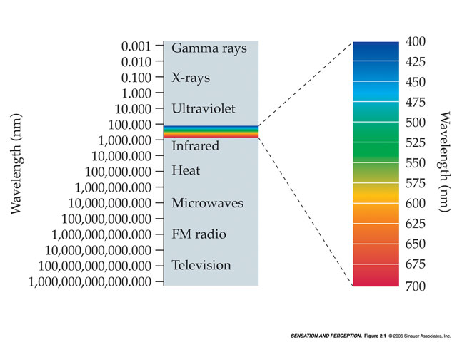
Light and the Spectrum of Electromagnetic Radiation
The duality of EMR – ‘packets’ of energy
400-700 nm wavelengths = Light. Why these wavelengths?
Photons: wavelength (color) and number (brightness)
Since light comes in ‘packets’, limited capacity to absorb
  the eye must continuously ‘regulate and regenerate’
E = mc²
HIGH ENERGY
Reflected
By
Gases
Increasingly
Able
To
Pass
Through
Solids
SHORT
WAVELENGTH (nm)
MEDIUM
Sun and stars emit all of these
WAVELENGTH (nm)
LONG
LOW ENERGY

Slide 3

SUN
S M L
EARTH

Slide 4
Vision
Pigments and reflected light
Color vision requires abundant light
So, we have TWO eyes (‘duplex’ eye: rods, cones)
Primaries for color vision (RGB)
Across-fiber pattern coding for color (using just three broadly-tuned receptors we can perceive an enormous number of different colors)
For example:
  ‘white’ = R-ON, G-ON, B-ON
  ‘yellow’ = R-ON, G-ON, B-OFF

Slide 5
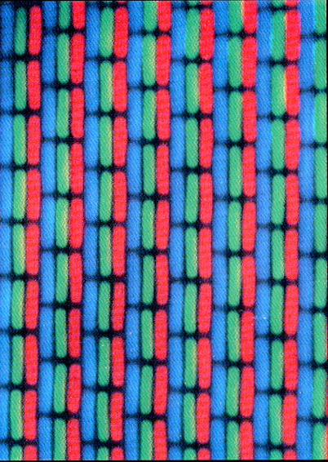
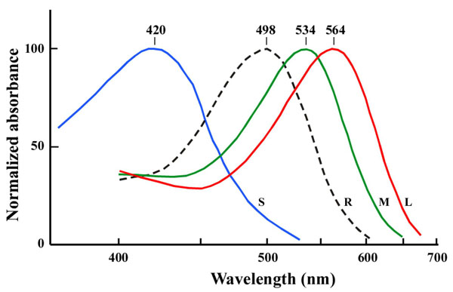
Blue
Green
Red
The Three Cone Pigments and the Rod Pigment
Visual system: pigments are characterized by wavelength that is absorbed
Everywhere else: pigments are characterized by wavelength that is reflected

Slide 6
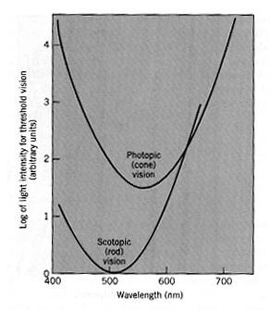
Rod vs. Cone Vision
Rods and Cones Differ in Sensitivity to Light (note that these ‘threshold’ curves are just inverted ‘absorbance’ curves)
Rods most sensitive to ‘green’ light (i.e. 510 nm)
The amount of light required for Photopic (Cone) vision is generally TOO MUCH light for Scotopic (Rod) vision.
Dark Adaptation
Log of light intensity for threshold vision
(arbitrary units)
Wavelength (nm)

Slide 7
EYE AND RETINA
The basic structure and function of the human eye/retina
Anatomy of the Eye (which are the moving parts?)
Function of curved optical elements of the eye (cornea, lens)
How does variation in the shape of the eye lead to poor eyesight?

Slide 8

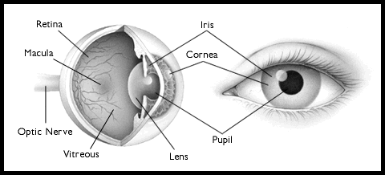
Structure of the Eye
Note: only 2 moving parts (iris and lens)

Slide 9
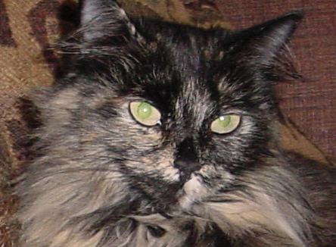
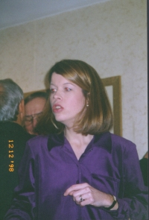
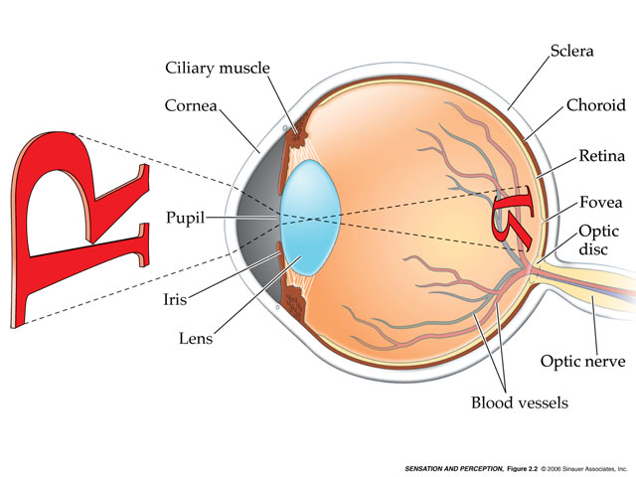
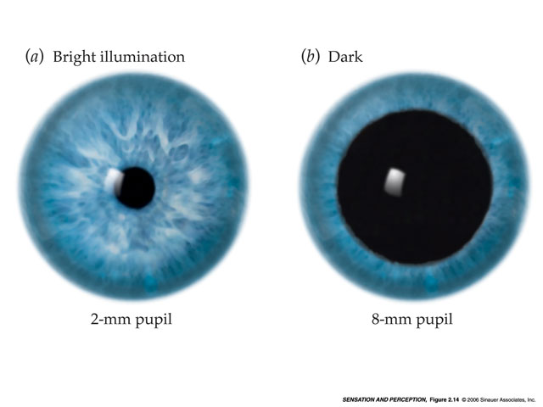
Structure of the Eye
The ‘curved’ optical elements of the eye –
cornea and lens. A microscope in reverse.

Slide 10
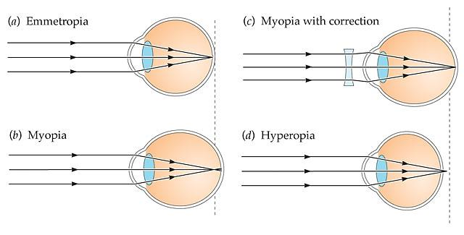
Structure of the Eye I
Eyeglasses and Contact Lenses ‘correct’ variation in the structure of the eye

Slide 11
EYE AND RETINA
Anatomy of Retina (photoreceptors, bipolar cells, ganglion cells)
  The Blind Spot (s)
  Fovea vs. Periphery of the human retina
How is the trade-off between detection and identification expressed in the eye (rods vs. cones)?
Acuity/Cones (Identification) vs. Sensitivity to Light/Rods (Detection)

Slide 12
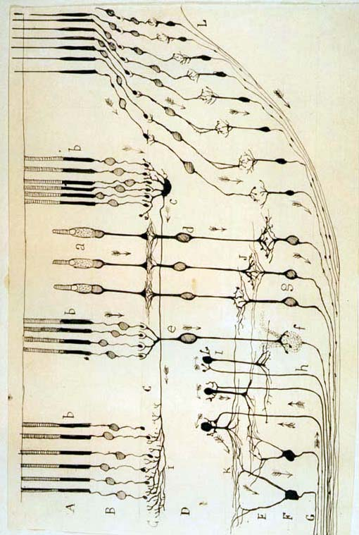
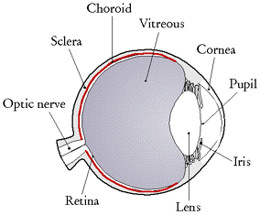
The retina is ‘installed’ backwards!?
light
photoreceptors
light
Optic Nerve
blind
spot
light
photoreceptors

Slide 13
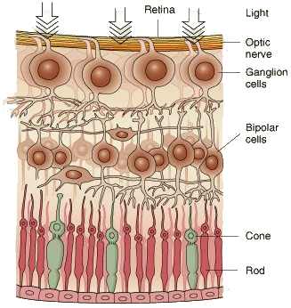
Retinal Cell Types
(typical mammal retina)
LIGHT
Fewest
Fewer
Many
Back of Eye

Slide 14
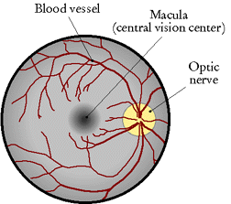
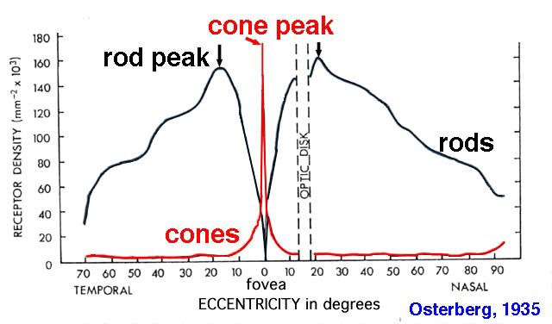
Human Retina

Slide 15
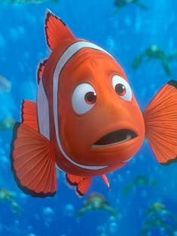
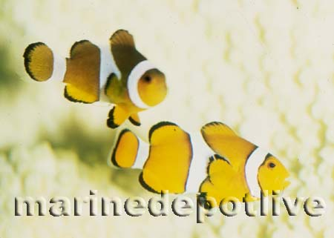

Slide 16
Low Detail
Low Threshold for Light, Movement
Fine
Detail
Low Detail
Low Threshold for Light, Movement
E
E
E
E
E
E
E
E

Slide 17

Low Detail
Low Threshold for Light, Movement
Fine
Detail
Low Detail
Low Threshold for Light, Movement
E
E
E
E
E
E
E
E

Slide 18
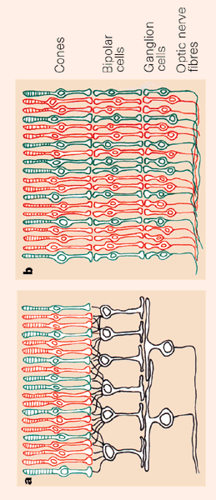
To Detect,
Or To Identify,
That Is The Question
You see:
Fine detail, but only works when light is abundant
Periphery Fovea
You see:
Low threshold for light, but lacks fine detail

Slide 19
EYE AND RETINA
How does phototransduction occur? In other words, how is a photon turned into the closing of Na+ channels?
Photoreceptor responses to light vs. Ganglion Cell responses to light (opponent process, contrast detection)
Color Vision (Trichromacy vs. Opponent Process) and Color Mixing (Subtractive vs. Additive Mixing).

Slide 20
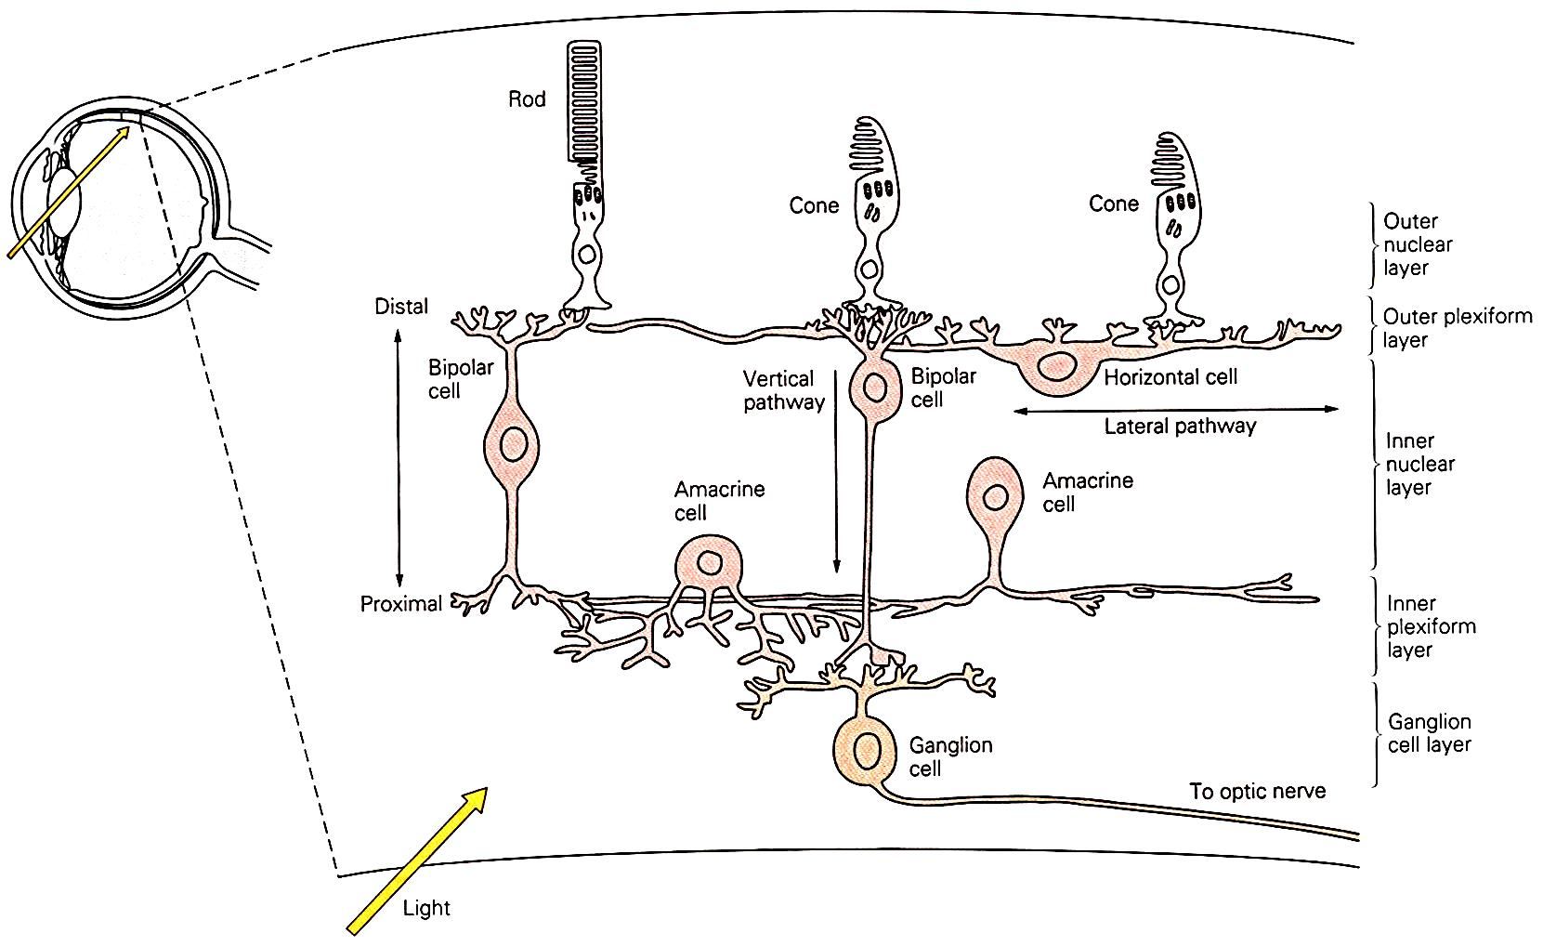
Phototransduction

Slide 21
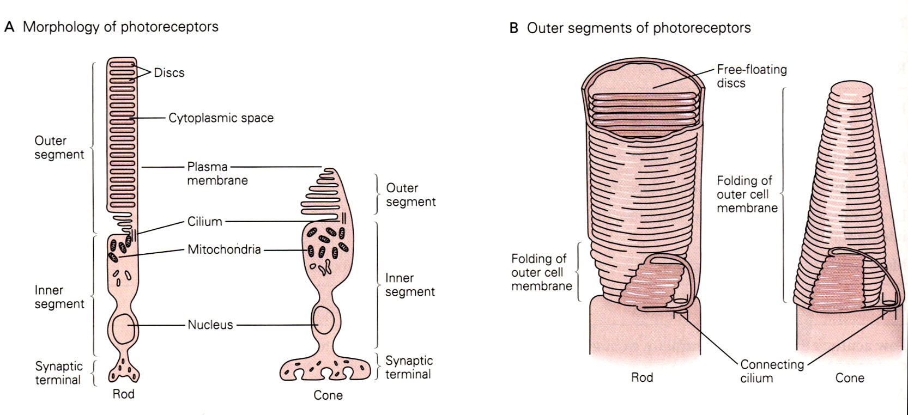
Light CLOSES Na+ Channels in Photoreceptors
Photons are absorbed by the disks

Slide 22
Disks are continuously shed and added
Photons are absorbed by the disks

Slide 23
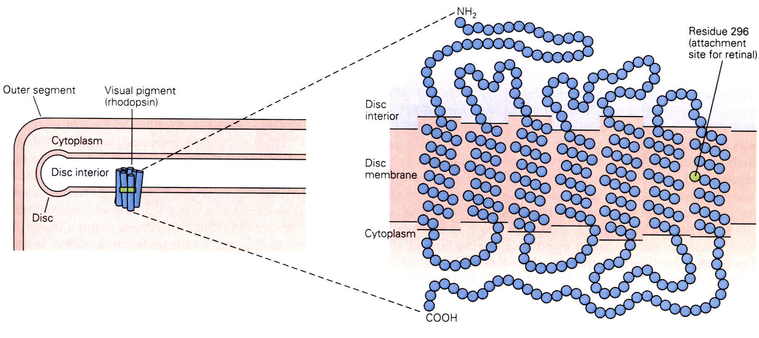
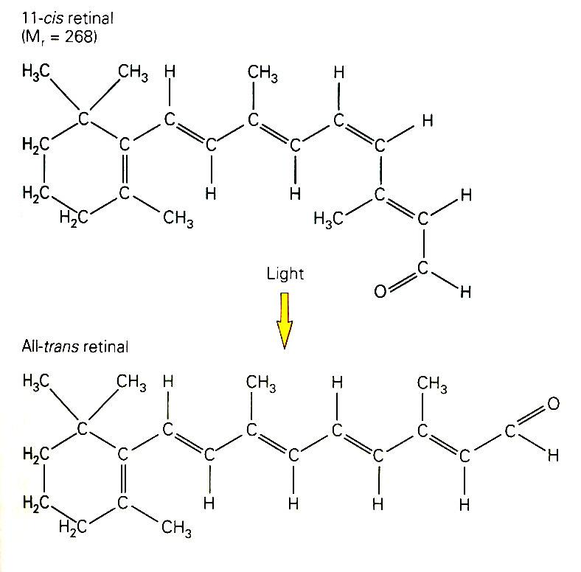
When struck by a photon, 11-cis retinal is converted to all-trans retinal (i.e., the photon changes the ‘shape’ of retinal).
This, in turn, alters the shape of rhodopsin, allowing it to couple to a G-protein and activate a ‘second messenger’.

Slide 24
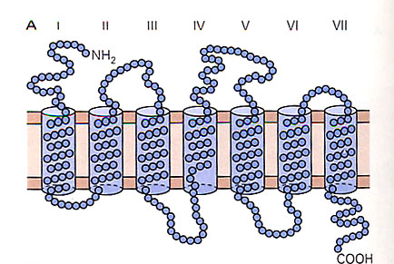
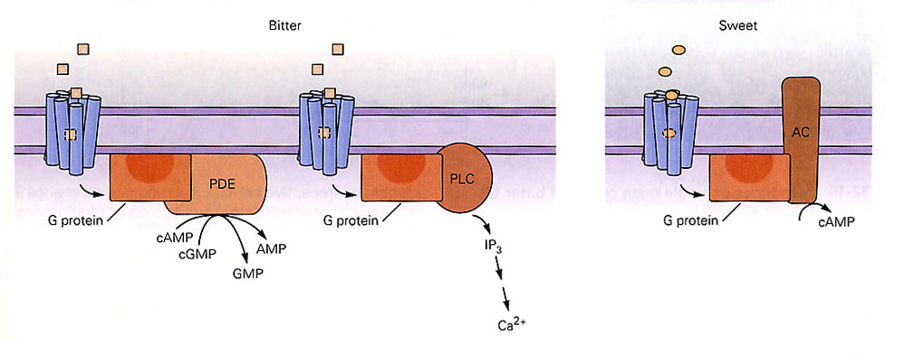
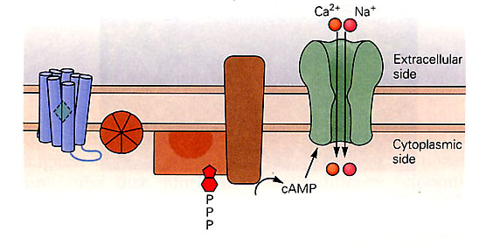
2nd Messenger Systems:
G-Protein Coupled
Receptors
The end result is similar to ‘1st Messenger’ systems

Slide 25
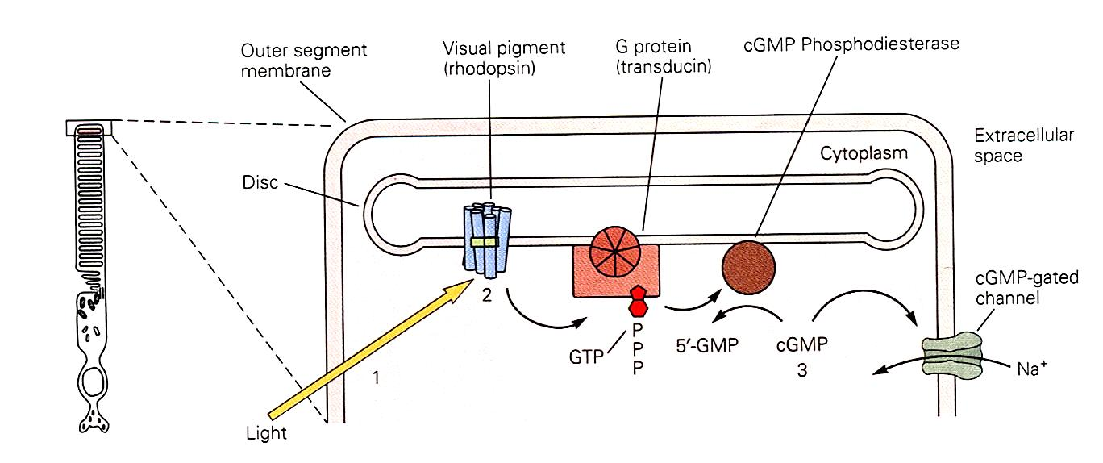
Visual Pigments are Metabotropic Receptors!
A ‘second messenger’ system closes the Na+ channel

Slide 26
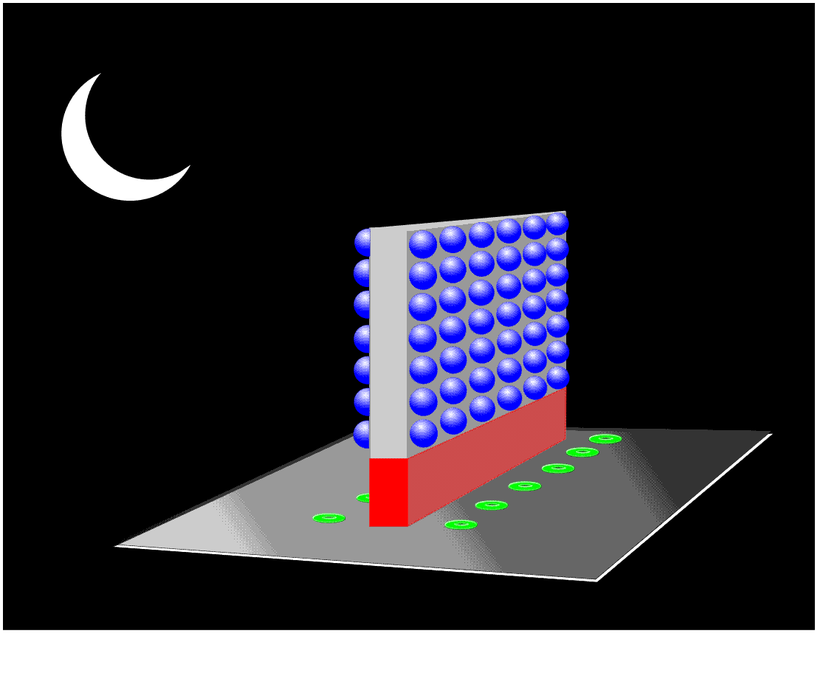
Inside a photoreceptor synaptic terminal….

Slide 27
Inhibitory Neurotransmitter
Rod
Bipolar
Disinhibited!!

Slide 28
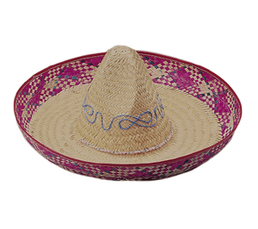
Receptive Fields of ‘Parasol’ RGCs
Center/surround organization – ‘Opponent Process’
Many (~200) photoreceptors (RODS) connect to one RGC
Imagine a sombrero (Mexican cowboy hat)
Edge enhancement
What ‘leaves’ the eye are dots of contrast (light/dark, or two-color)
RGC
Excitatory Center
Inhibitory Surround
The RGC only fires if there is more light on the center than on the surround (i.e., contrast)

Slide 29
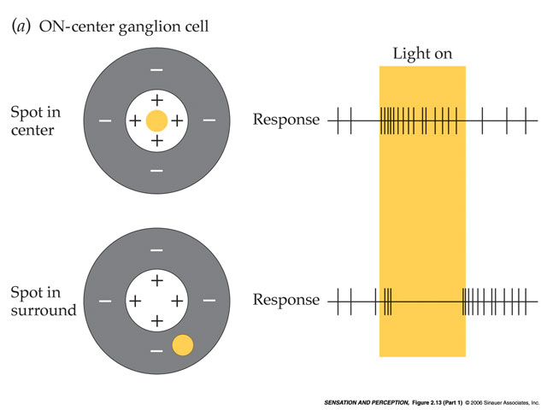
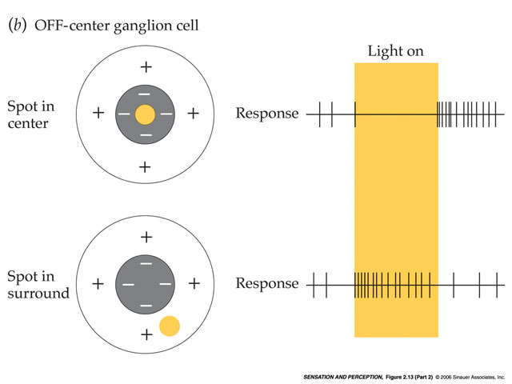
Receptive Fields of ‘Parasol’ RGCs
Center/surround - on/off or off/on – ‘Opponent Process’
Illuminating the entire receptive field has no effect

Slide 30
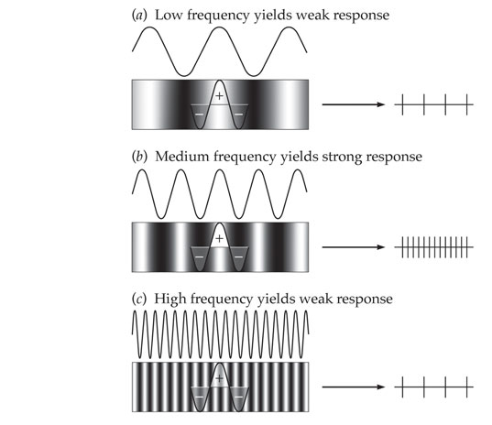
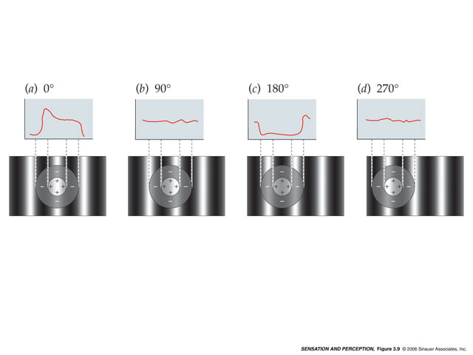
Receptive Fields of ‘Parasol’ RGCs
Center/surround - on/off or off/on – ‘Opponent Process’
RGC responses to ‘spatial frequencies’

Slide 31
Excitatory Center
Inhibitory Surround

Slide 32


Slide 33
Theories of Color Vision
Trichromatic Theory
  Light of three wavelengths sufficient to produce entire visible spectrum
  Color determined at level of CONES

Slide 34
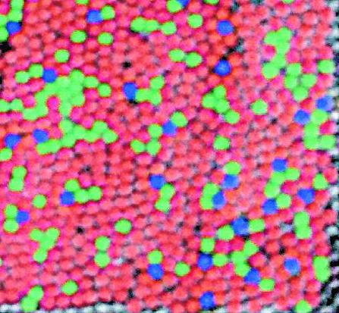
Receptive Fields of ‘Midget’ RGCs
One photoreceptor (CONE) connects to one RGC
Contrast Enhancement
Decreased sensitivity to light, movement
Increased acuity (resolution)
Fovea

Slide 35
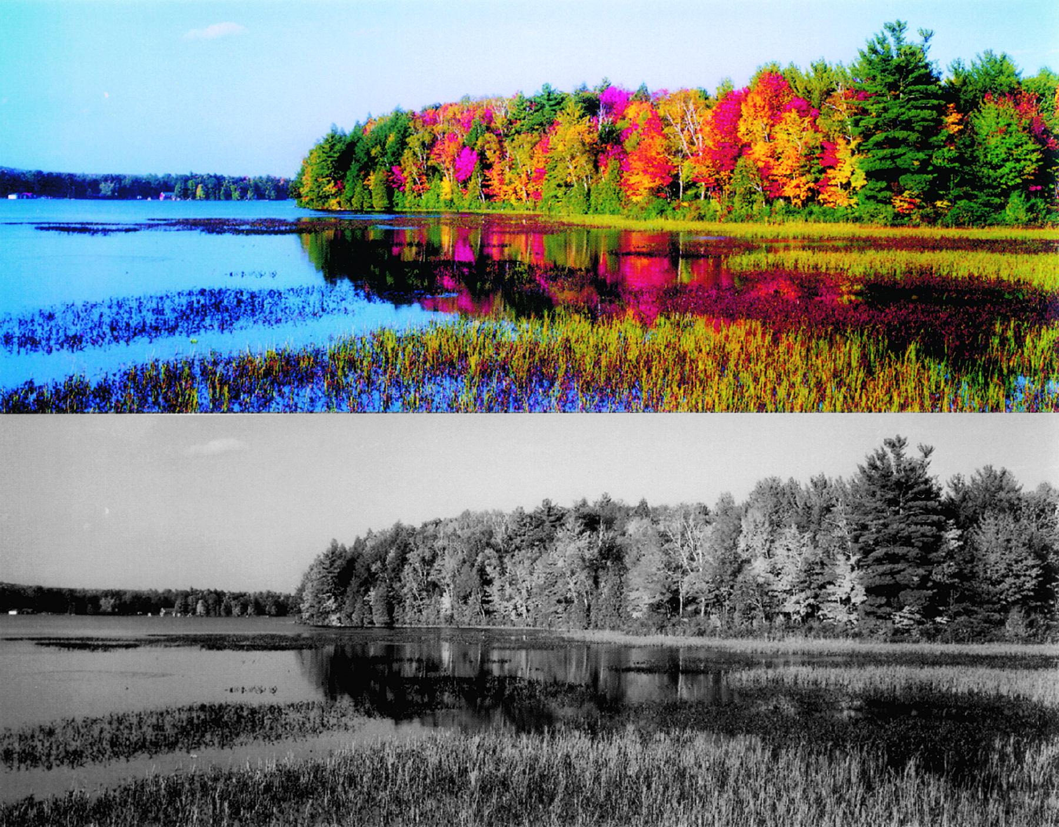
Advantages of Color

Slide 36
Theories of Color Vision
Opponent-Process Theory
  blue-yellow
  red-green
  white-black
  Return of the Sombrero (inhibitory process, afterimages)
Color Determined at the level of CORTEX

Slide 37
Neurons with ‘Double Opponent Process’
Receptive Fields are found in CORTEX. Notice that the connectivity of the fovea cannot support these types of receptive fields.
Fovea
The purpose of these receptive fields is to use COLOR as an added form of CONTRAST – to highlight the borders between objects of different colors.

Slide 38

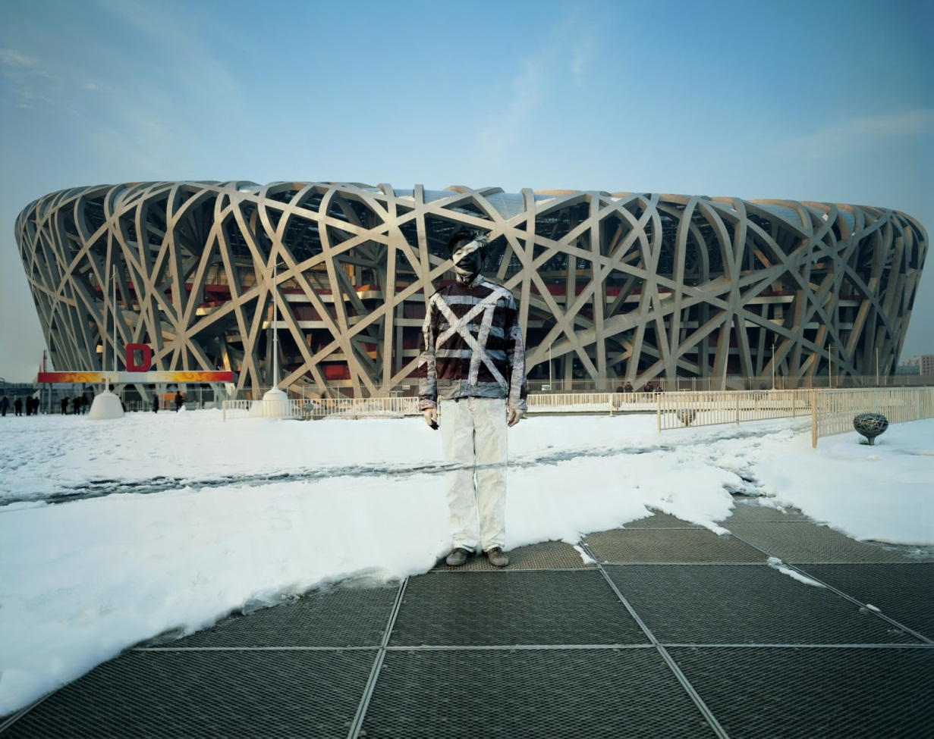

The artist Liu Bolin demonstrates how we depend on color contrasts to define the borders between objects.

Slide 39
Color Mixing
Subtractive Mixing (Ink on Paper)
Additive Mixing (Computers, TVs)

Slide 40
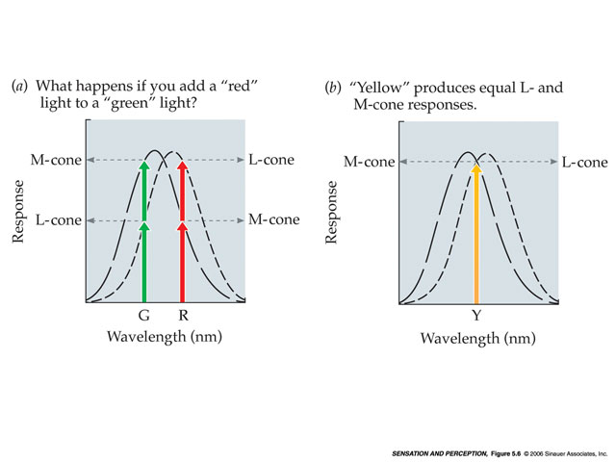
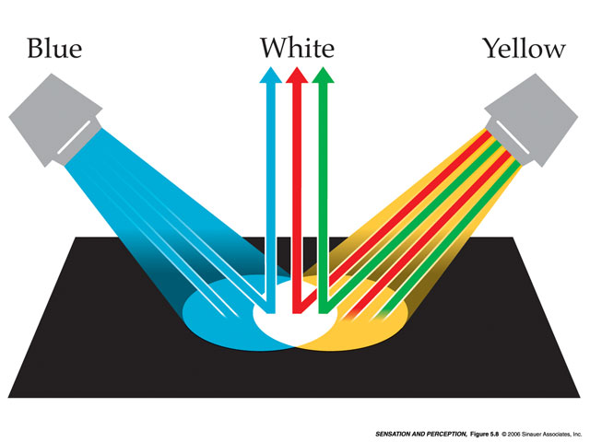
Color Mixing
Additive Mixing
Televisions, Computers
‘Adding’ together various amounts of RGB light produces thousands of colors

Slide 41
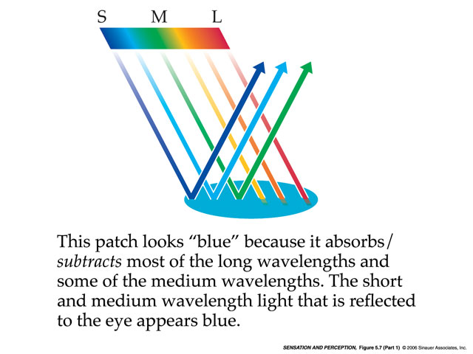
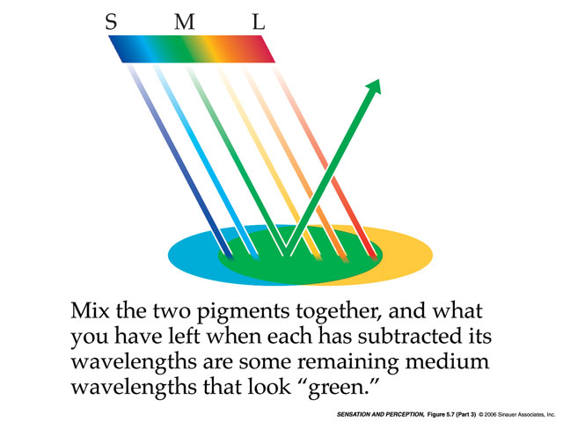
Color Mixing
Subtractive Mixing
Must have ‘white’ light
Pigments
‘Subtracting’ wavelengths from the white light produces thousands of colors

