Slide 1
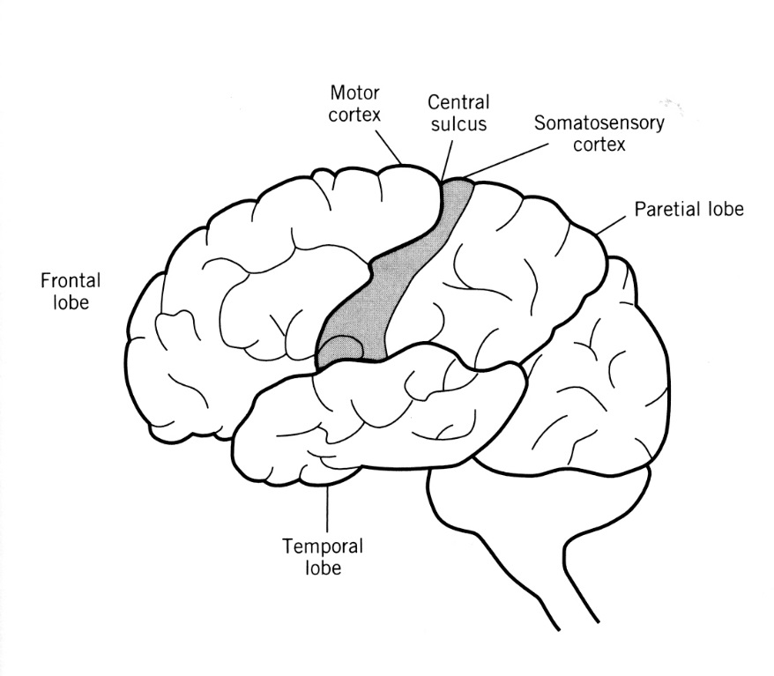
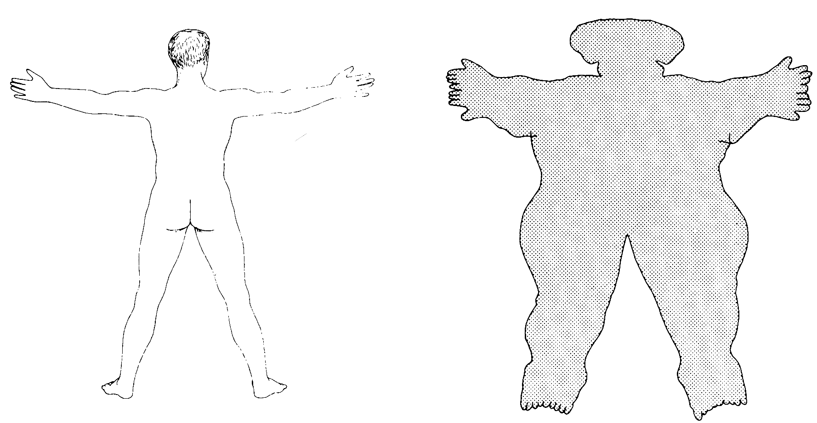
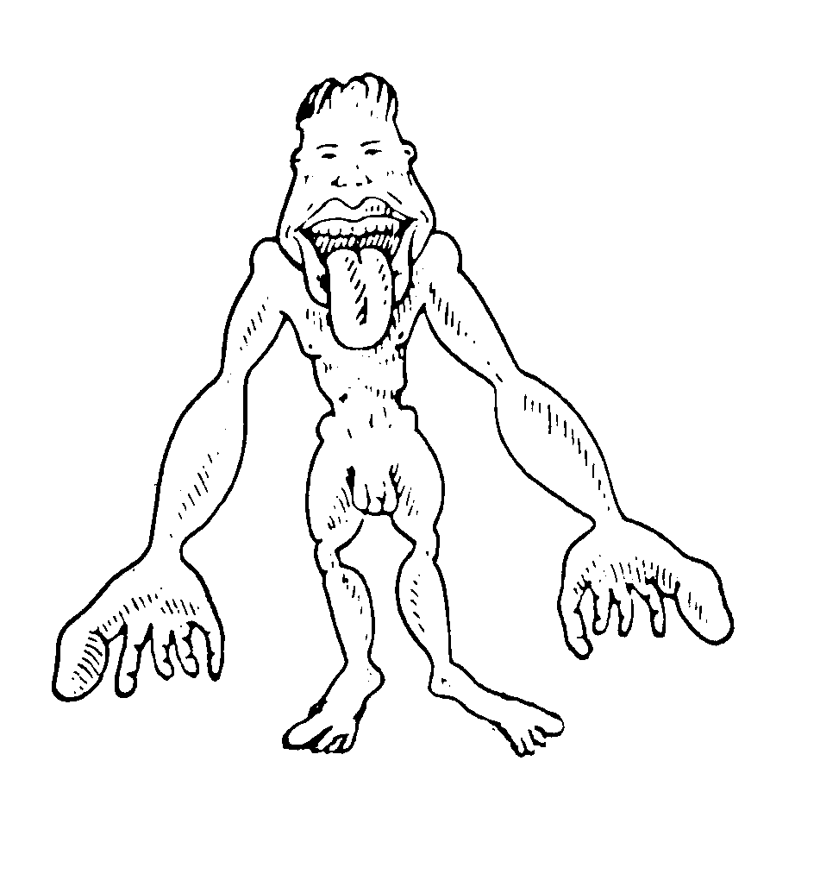
The Skin: Largest Organ in the Body
Distortion due to variation in the size and density of sensory neuron ‘receptive fields’

Slide 2
The Stimuli of Somatosensation
SKIN (body surface)
  Mechanical pressure: this is ‘touch’
  Vibration (Hz): this is generally ‘texture’
  Damage/Temp (pain/hot/warm/cold)
  Chemical (example is menthol)
MUSCLES &TENDONS (body position)
  Stretch, Tension
  Kinesthesis, Proprioception
BODY SURFACE + BODY POSITION = “HAPTIC PERCEPTION”

Slide 3
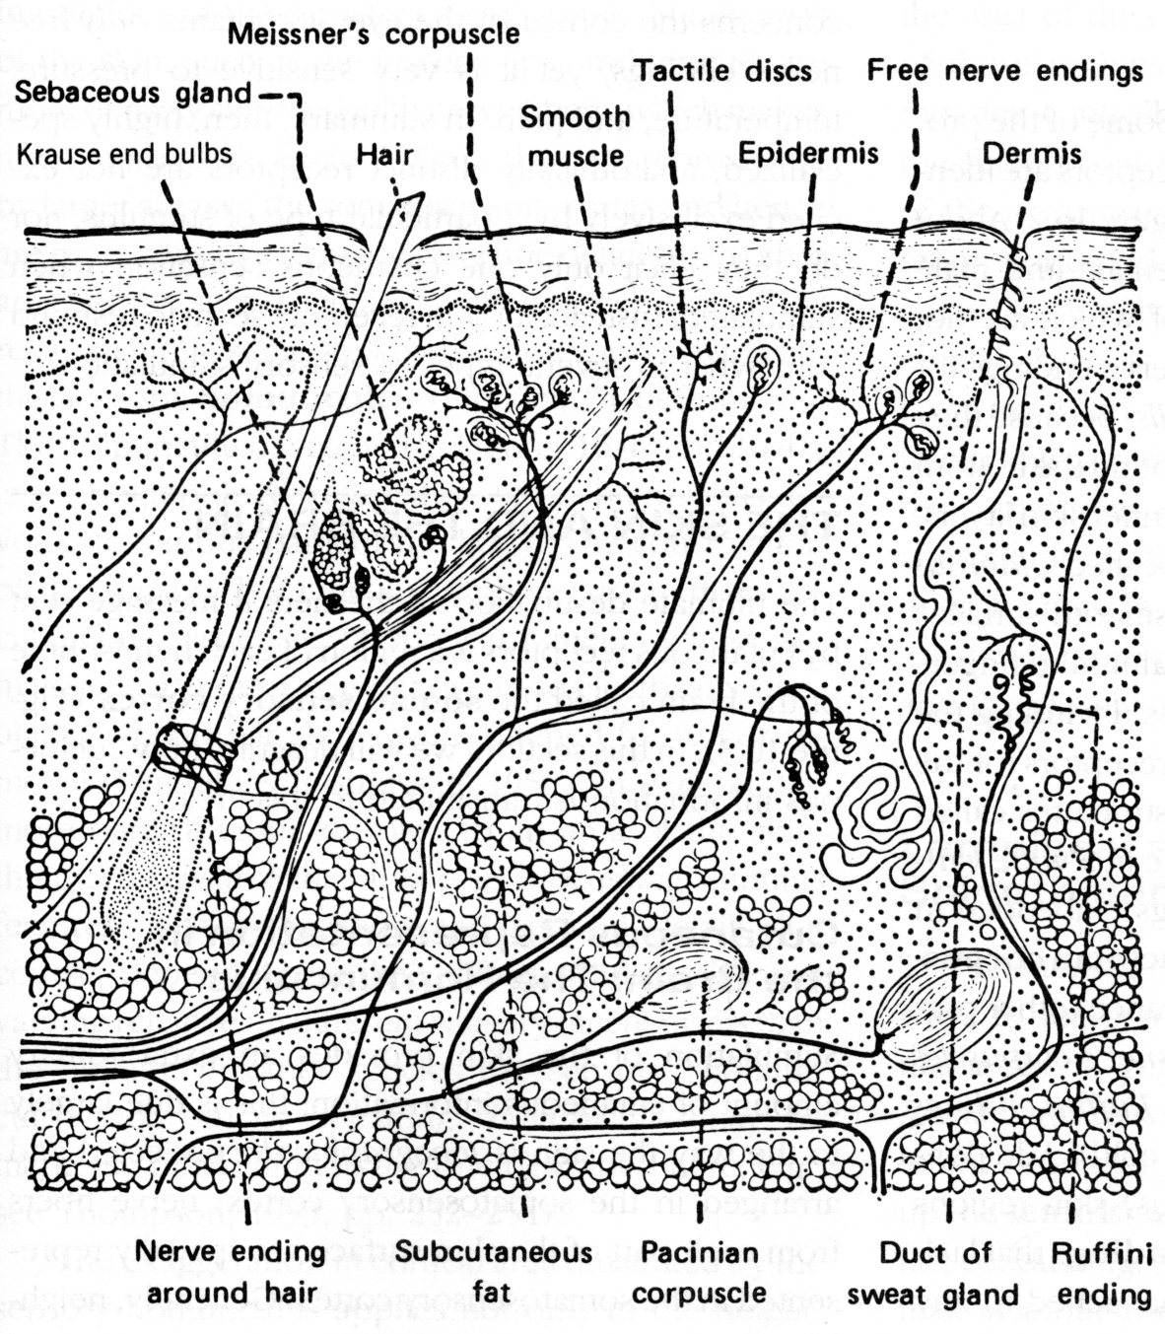
Free Nerve Endings
Receptors can be characterized in terms of:
Stimulation Type (pressure, vibration, temp, damage)
Size of Receptive Field (amount of branching)
Rate of Adaptation (slow, medium, fast)
Basket Cell
Pacinian corpuscle

Slide 4
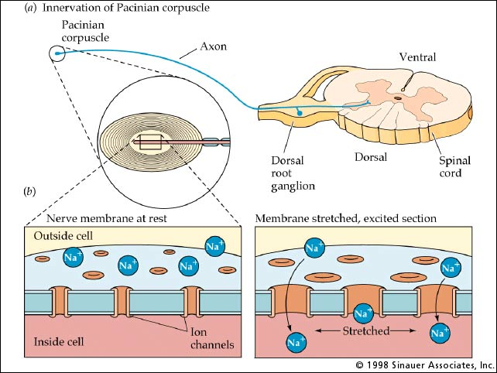

Slide 5

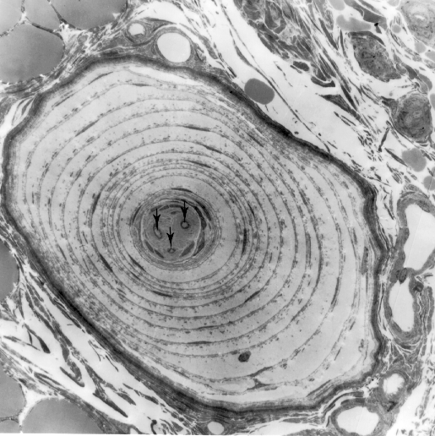
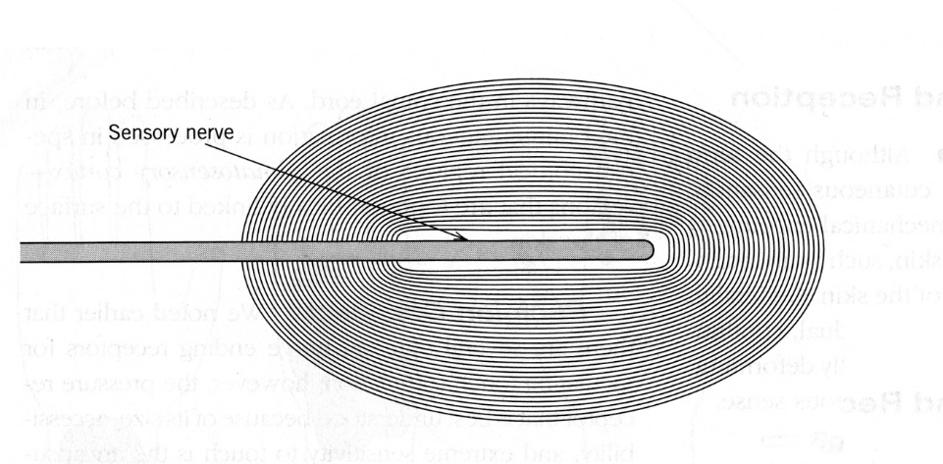
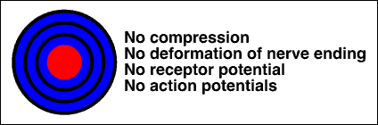
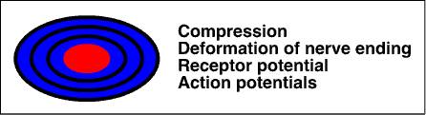

Pacinian Corpuscles
Detect Vibration (texture)
Pressure
Stimulus
Pacinian
Activity

Slide 6
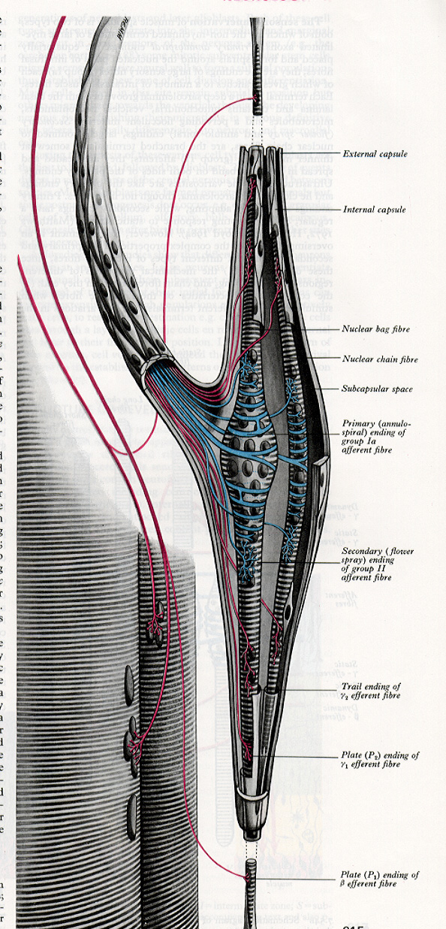
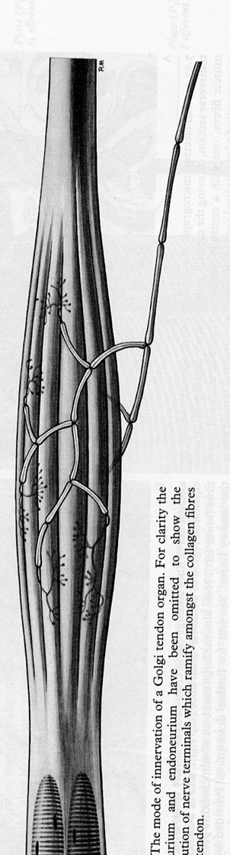
Bone
Red is motor
Sensory fiber
attached to tendon
Receptors in Muscles and Tendons
Encode Body Position
Golgi Tendon Organ – Tension Receptor
Muscle Spindle – Stretch Receptor
Blue is sensory
Muscle fiber
Muscle

Slide 7
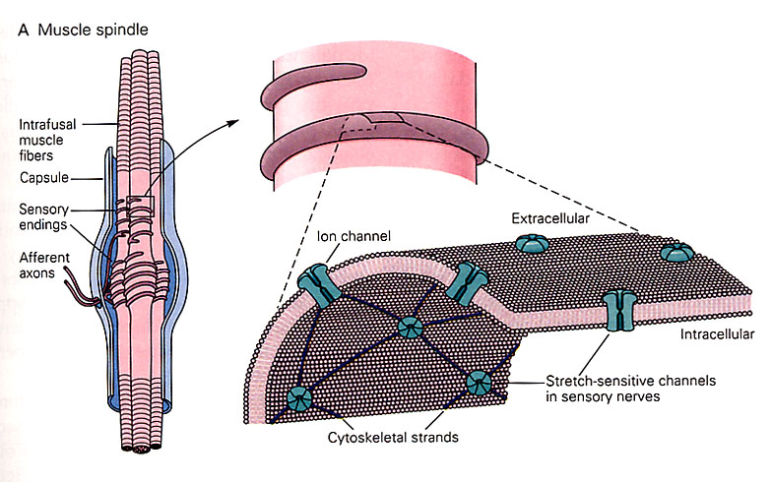
This is a Muscle spindle,
but other Mechanoreceptors (i.e., Basket Cells and Pacinian Corpuscles) also work this way
The cytoskeletal strands are like the ‘tip links’ of inner hair cells. Ion channels ‘pulled open’ by mechanical force.

Slide 8
Skin Senses: 2 Pathways to Cortex
Lemniscal Pathway (mechanorecepetors)
  Tactile, pressure, Basket Cell (detect)
  Tactile, vibration/texture, Pacinian Corpuscle (ID)
Spinothalamic Pathway (free nerve endings)
  Tissue Damage, pain, Nociceptor (detect)
  Temperature, hot/cold, Thermal Receptor (ID)
  This pathway is ‘gated’ in the spinal cord

Slide 9
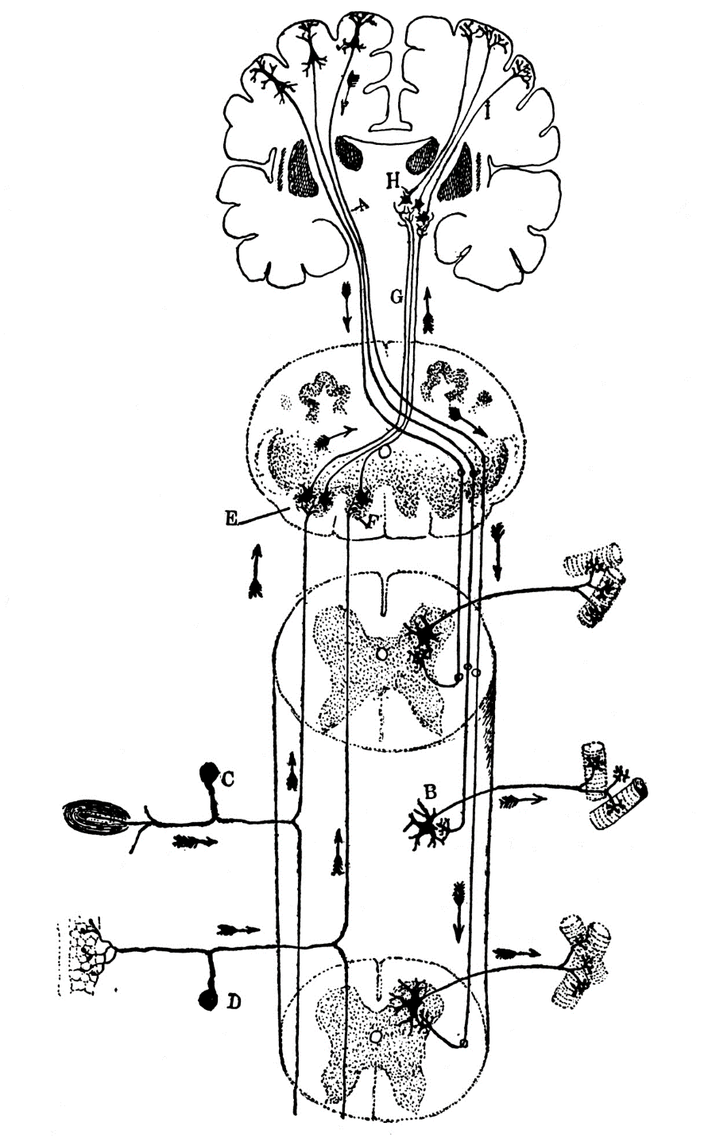
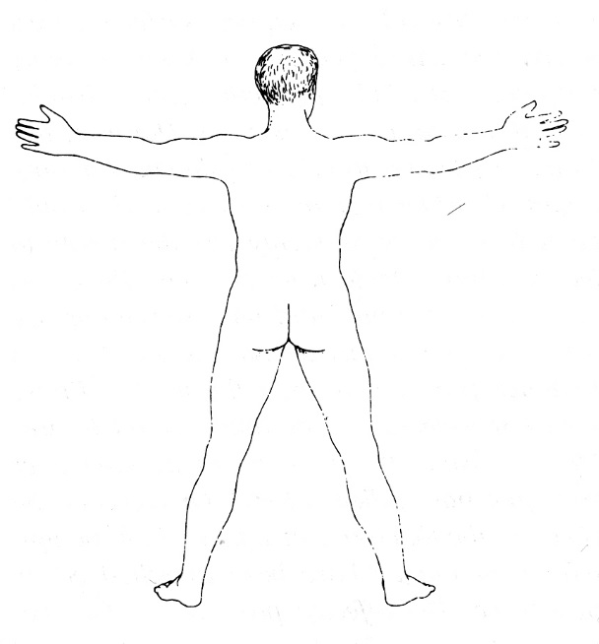
Thinking in 3D
Dorsal/Ventral Organization
Left/Right Crossing
Cortex
frontal
Cortex
parietal
Thalamus
D
O
R
S
A
L
Hindbrain
Dorsal
MUSCLES
Ventral
SENSORY NEURONS
MUSCLES
Ventral
Dorsal
Spinal Cord
Thalamus
D o r s a l – S e n s o r y
Hypothalamus
V e n t r a l – M o t o r

Slide 10
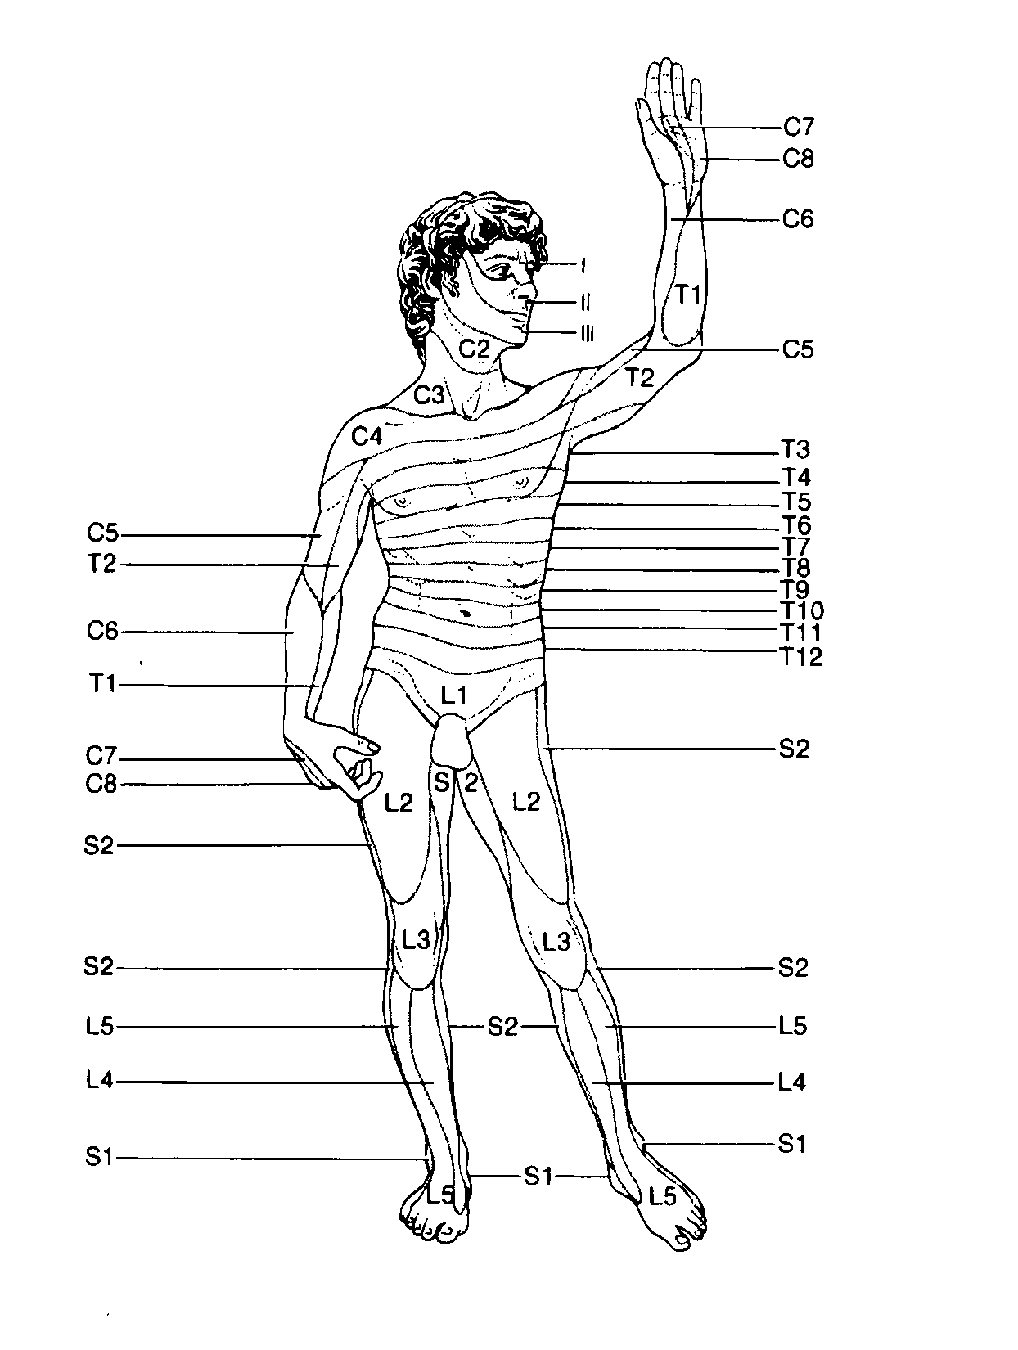
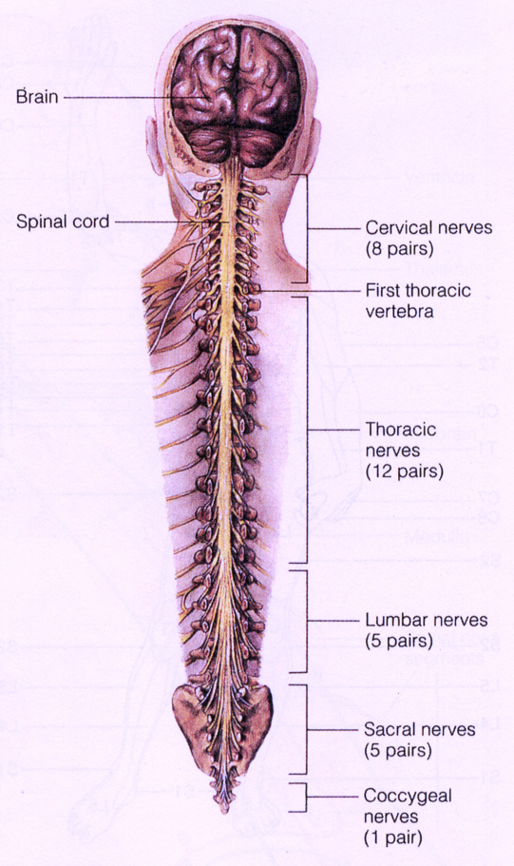
Somatotopic Organization

Slide 11
Primary Cortex
Thalamus
2D Receptor
Array
However…

Slide 12
Cortex Is
‘Modular’
Means the size and density of cortical columns is fixed
Thalamus
Dense 2D
Receptor Array

Slide 13


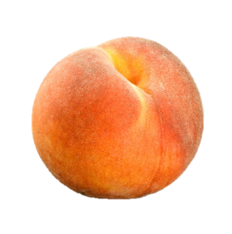
Fuzzy
Lemniscal System
(mechanoreceptors)
Cortex
frontal
Cortex
parietal
Thalamus
Hindbrain
Spinal Cord
PACINIAN
CORPUSCLE

Slide 14
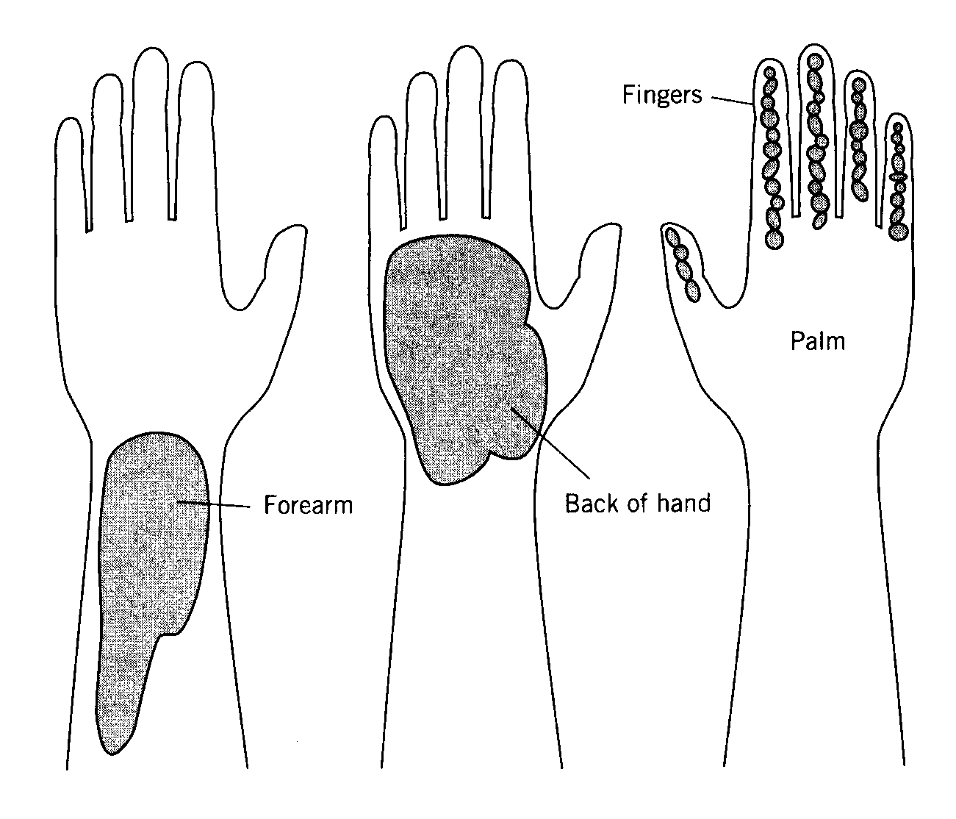
Receptive fields periphery vs. cortex
Stimulation anywhere within this large receptive field goes to one cortical column
Stimulation within this tiny receptive field goes to one cortical column

Slide 15
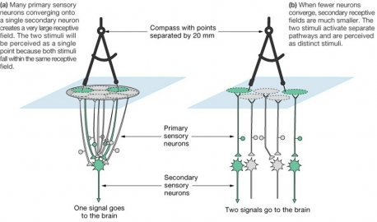
Two-Point Discrimination
Converging neurons =
Less discrimination,
Lower threshold
Less convergence=
More discrimination,
Higher threshold
Detect
Identify
Notes:
You can determine your own receptive fields by doing a two-point touch experiment.
Have a partner place the point of either one or two pencils (a few millimeters apart) against your skin (don’t look!)
Determine whether you can feel one point or two.
Areas to try: Forearm, back of the neck, shoulder, lips.
Which areas of your skin were you able to easily discriminate two points? Which areas were more difficult?

Slide 16
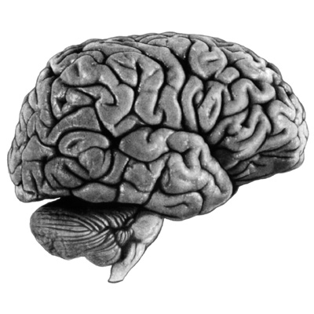
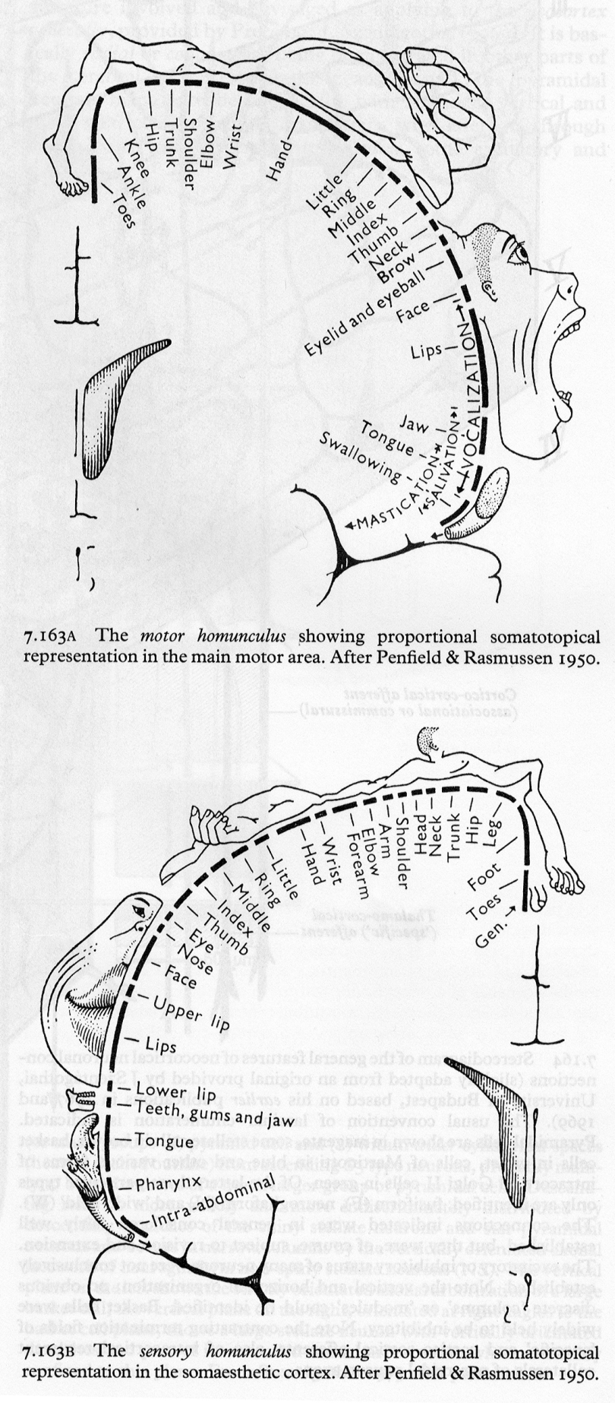
The brain has no ‘sense’ of itself
Sensory
(parietal)
Motor
(frontal)

Slide 17
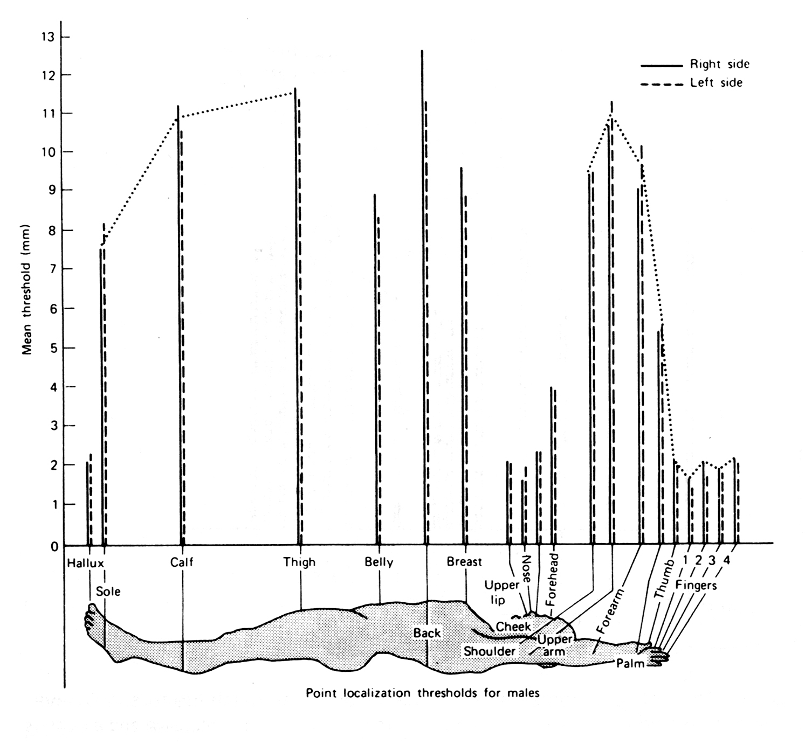
Two-Point Thresholds
Where best for Braille?

Slide 18
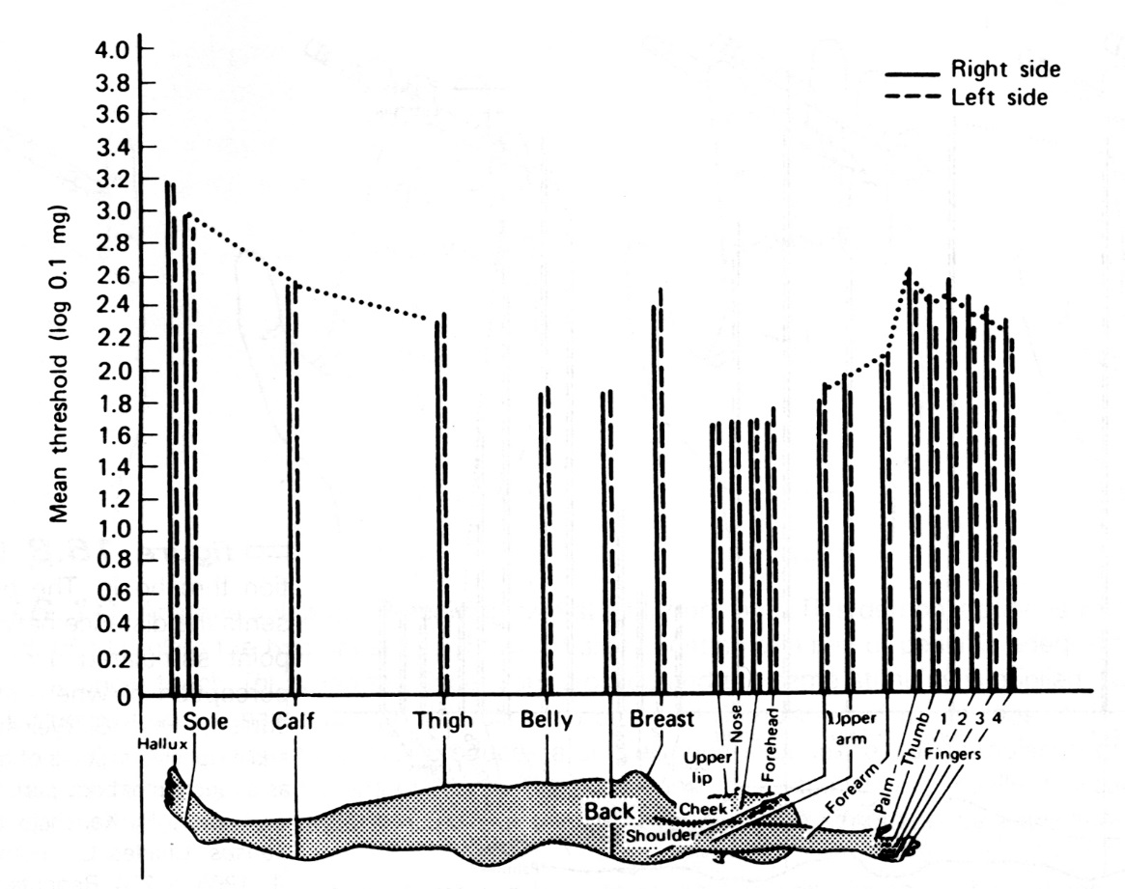
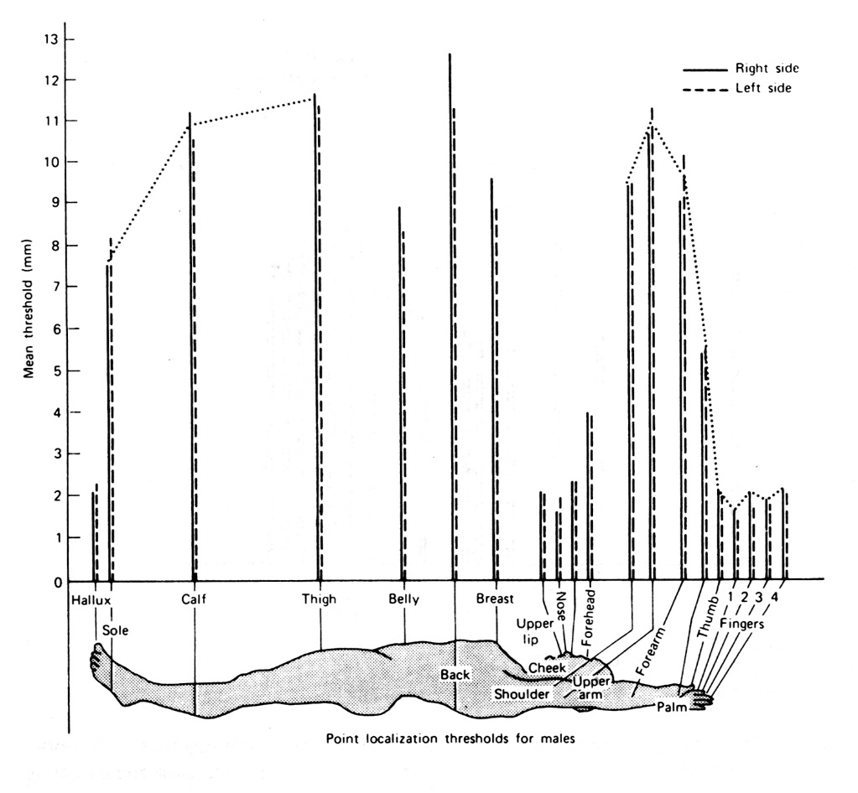
Thresholds for Detection and Identification
Pressure
(Detect)
Two-Point
(ID)

Slide 19
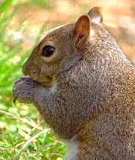
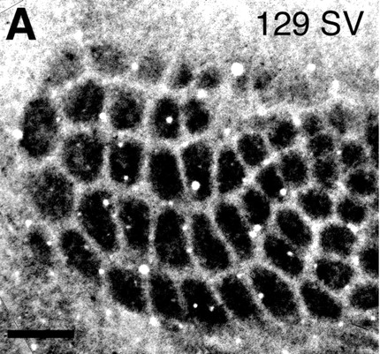

Receptive fields periphery vs. cortex

Slide 20
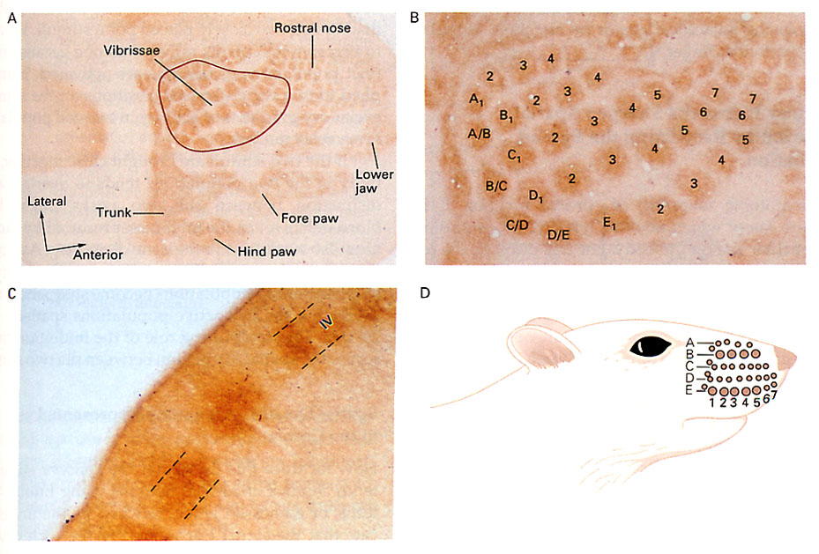

Slide 21

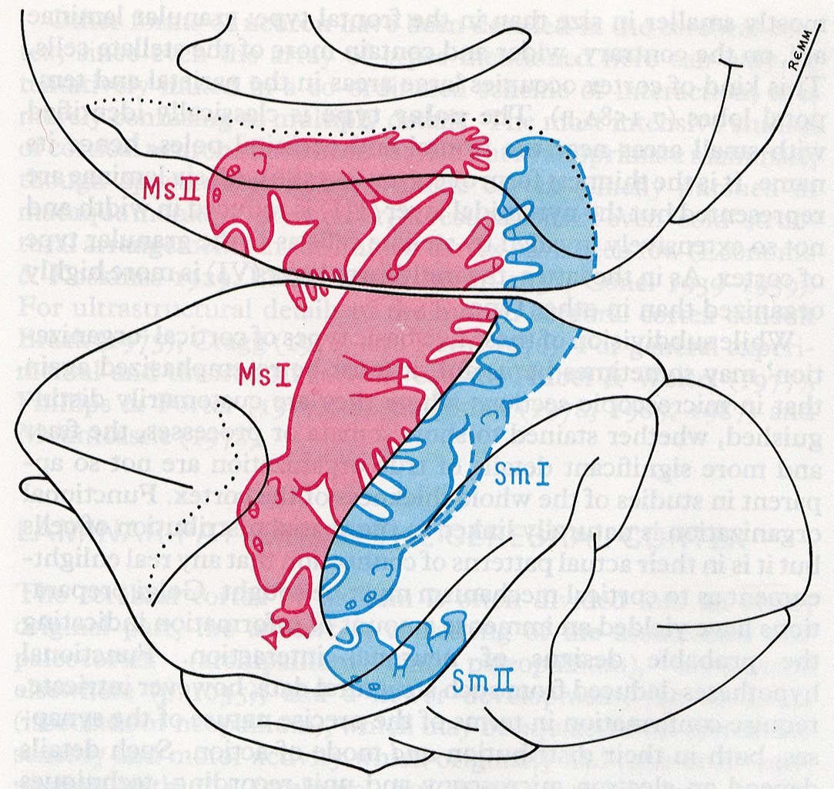
Monkey
Cortex

Slide 22

Experience Changes Cortical Maps
what happens if you lose a finger?
cortical maps will readjust
experience alone can readjust - the example of violin training - young vs. old

Slide 23
What is the result of all this ‘experience’?
Smart? Dumb? Dumber?

Slide 24
Variation in Cortical Maps
Overall brain weight differs by ~30%
Size of primary cortical areas
differs by as much as 100%

Slide 25
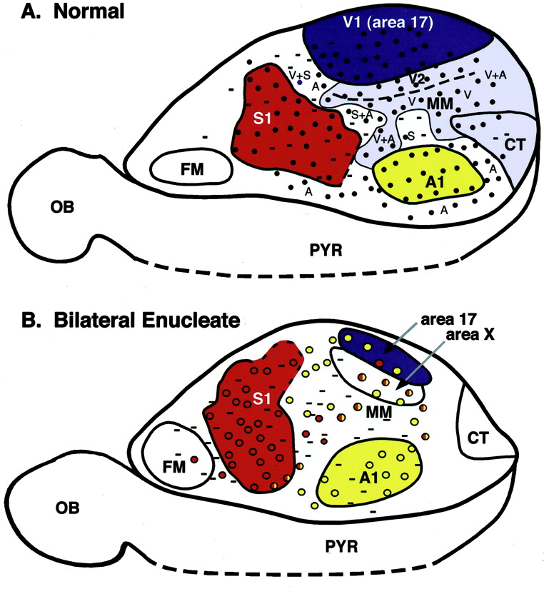
Normal
Cortex is allocated based on use
The beauty of modular architecture
“Columns is Columns”
Blind
Touch
Vision
Audition

Slide 26
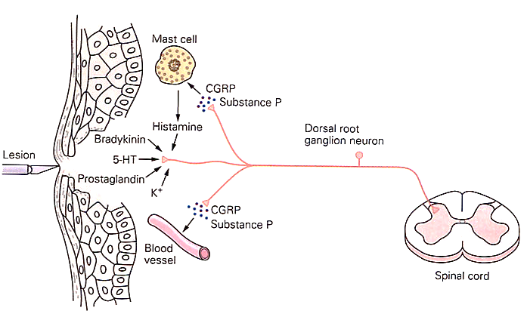
Pain Is A Perception:
The Stimulus is Tissue Damage
Pain
Pain
Pain
Pain
Nociceptors respond to AND release chemical stimuli
(the basis of inflammation)

Slide 27
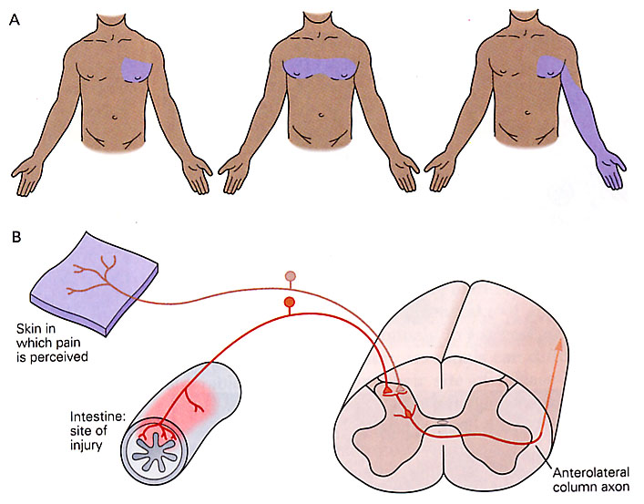
Heart Attack?
Lung Pain?
Arm Pain?
Convergent Excitation: lower thresholds (better detection) come at a cost of lousy ID.

Slide 28
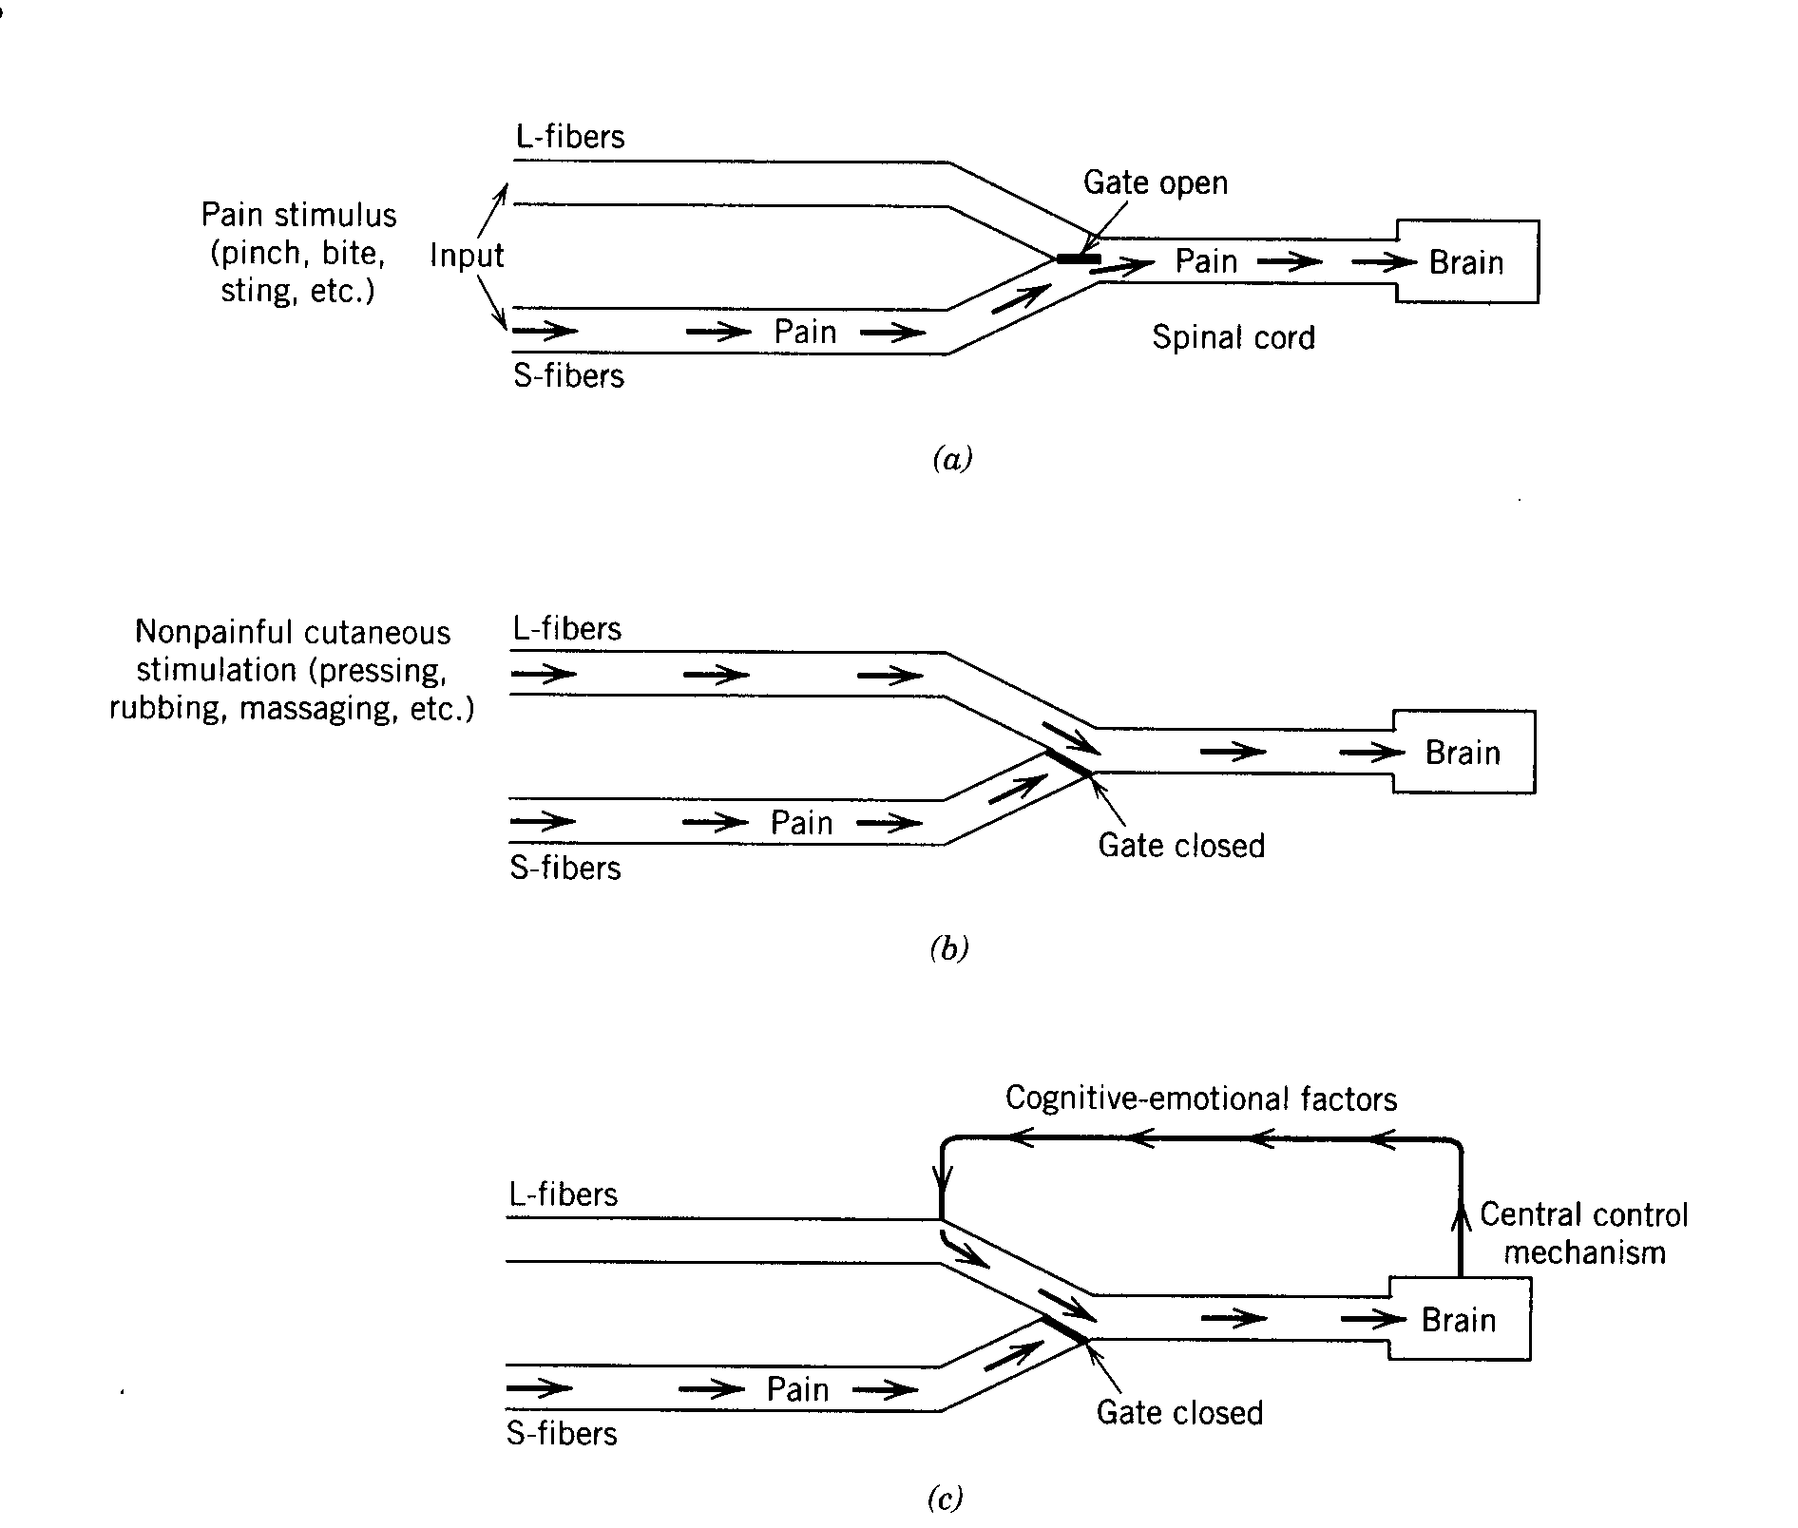
Spinal Gate Theory:
L-fibers are mechanoreceptors
S-fibers are free nerve endings
1.
Two Ways to Inhibit
2.

Slide 29
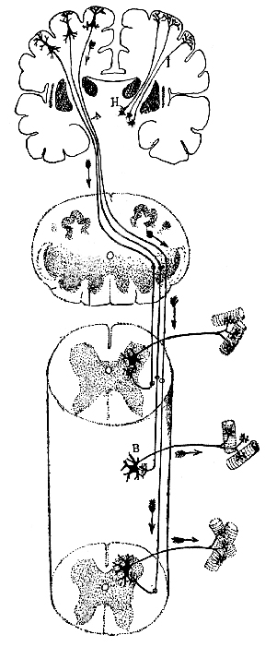


Spinothalamic System
(free nerve endings)
Cortex
frontal
Cortex
parietal
OUCH!
Thalamus
3.
Hindbrain
Spinal Cord
2.
1. Nociceptor (excitatory)
2. Mechanoreceptors (excitatory)
3. Modulatory Brainstem neurons (excitatory)
Opiate Neuron (inhibitory)
1.

Slide 30
Spinothalamic System
(free nerve endings)
Cortex
frontal
Cortex
parietal
Thalamus
3.
Hindbrain
Spinal Cord
2.
1. Nociceptor (excitatory)
2. Mechanoreceptors (excitatory)
3. Modulatory Brainstem neurons (excitatory)
Opiate Neuron (inhibitory)
1.

Slide 31
Spinothalamic System
(free nerve endings)
Cortex
frontal
Cortex
parietal
Thalamus
3.
Hindbrain
Spinal Cord
2.
1. Nociceptor (excitatory)
2. Mechanoreceptors (excitatory)
3. Modulatory Brainstem neurons (excitatory)
Opiate Neuron (inhibitory)
1.

Slide 32
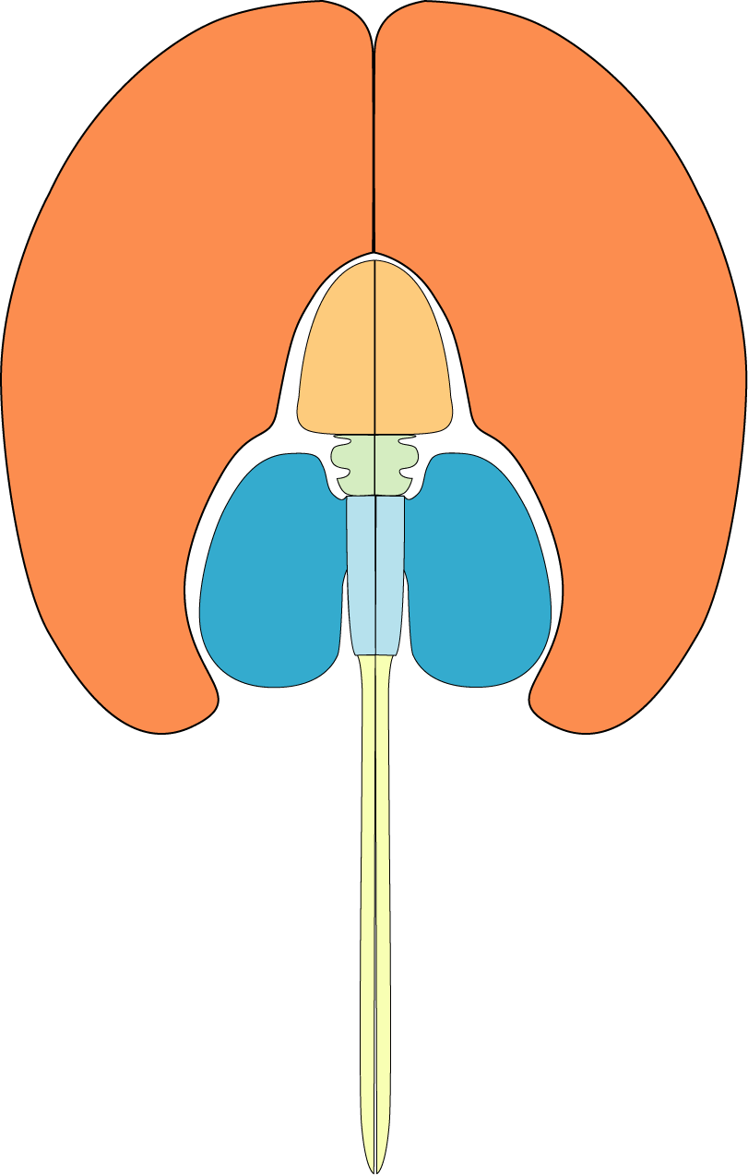
Architecture of
‘Modulatory’ Systems
Midbrain
(DA)
Hindbrain
(5-HT, NE)
“one-to-many”
Dopamine (DA)
Serotonin (5-HT)
Norepinephrine (NE)

Slide 33
Endogenous Opiates
Common practice to name neurotransmitters after the plant-derived chemical that mimics their action in the brain
Morphine-like neurotransmitters
Endorphins, Enkephalins
Role in suppressing pain (i.e., inhibiting input from nociceptors)
Opiate neurons found throughout brain and spinal cord – not all are involved in pain

Slide 34
EPSP: glutamate
IPSP: gaba or endogenous opiate
+
YES!
NO!
-
Synaptic potentials are brief (a few milliseconds) positive or negative changes in voltage.
Occur at dendrites – positive and negative summate.
Caused by neurotransmitter released from a presynaptic neuron.
EPSPs increase likelihood of action potentials, IPSPs decrease that likelihood.
Drug effect: excitatory agonist
YEEEEEEEEEEEEEEEEEEEEEEEEEEEEEESSSSSSSSSSSSSSSSSSSSSSSSSS!
Agonist drugs can also produce positive or negative changes in voltage.
They do so by mimicking the chemical structure of naturally-occurring neurotransmitters.
However, the DURATION of their effects can be minutes or hours.
Neurons respond to this stimulation by making themselves more or less excitable.
Leads to dose tolerance and with persistent use, chemical dependence.
NOOOOOOOOOOOOOOOOOOOOOOOOOOOOOOOOOOOOOOO!
Drug effect: inhibitory agonist

Slide 35
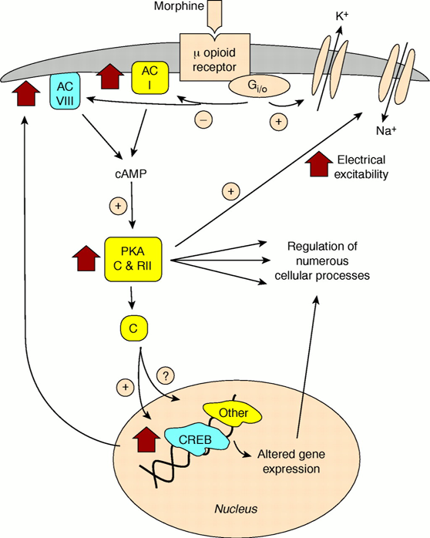
Why drugs produce chemical dependence. . .
. . . even ‘good’ ones
Short term effect of morphine is increase in K⁺ current
Long term effect of morphine is increase in Na⁺ current

Slide 36
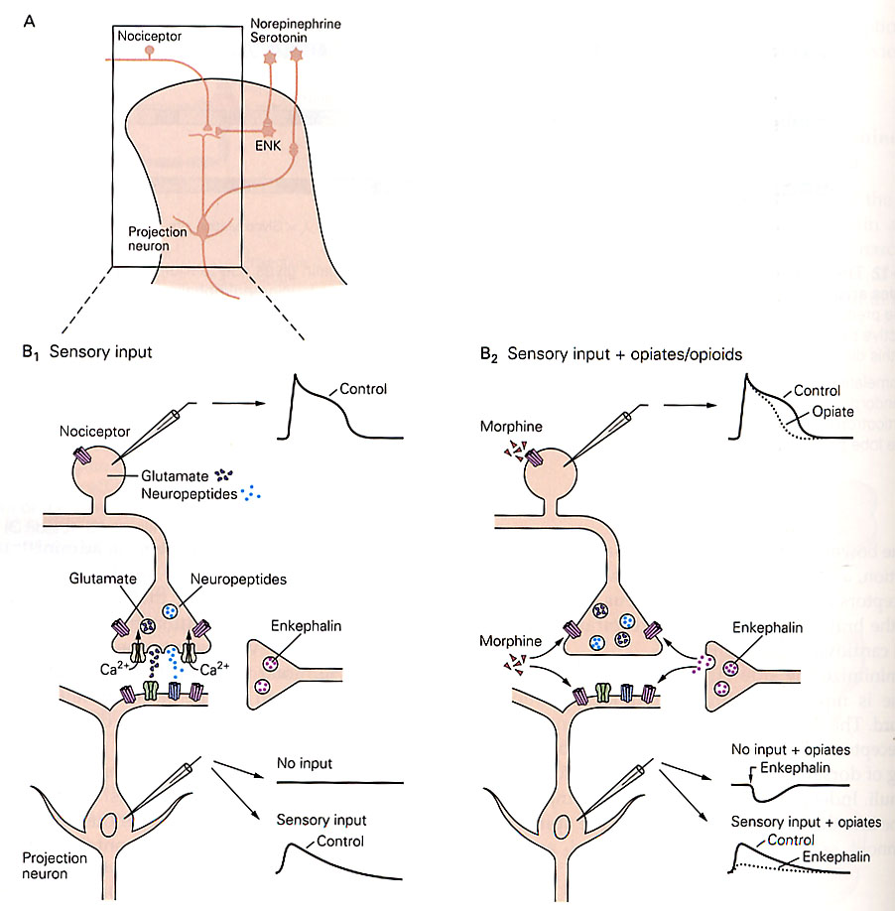
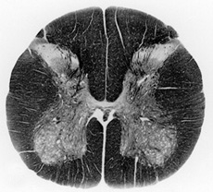
The ‘Spinal Gate’ in action
Cell bodies in
brainstem
dorsal
ventral

Slide 37
Activation of a Nociceptor

Slide 38
Activation of a Nociceptor: Inhibition by Enkephalin / Morphine

Slide 39
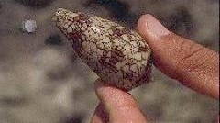
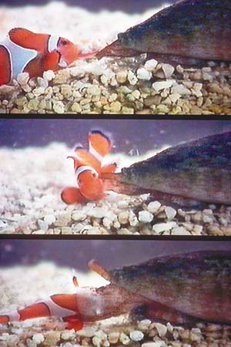
Cone Snail Venom
Venom consists of a
‘cocktail’ of proteins
One of these venom
proteins blocks ‘N’
type calcium channels
Nociceptors have ‘N’
type calcium channels
on their axon terminals

Slide 40
Where a venom (or drug) could work. . .
Receptor Agonists / Antagonists
Reuptake Inhibitors
Neurotransmitters
K⁺
Na⁺
Ca⁺⁺

