Slide 1
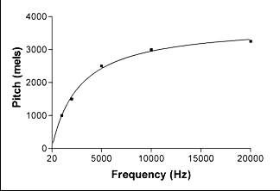
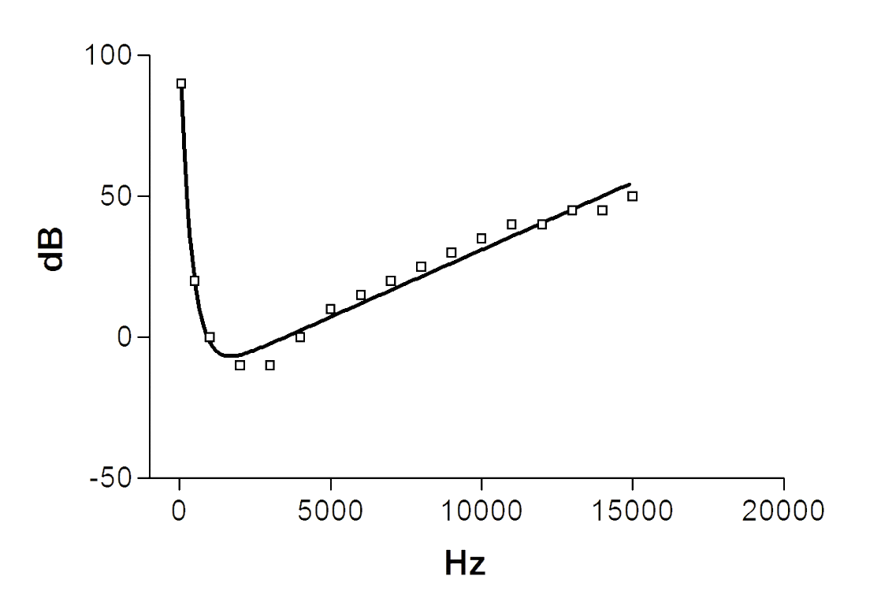
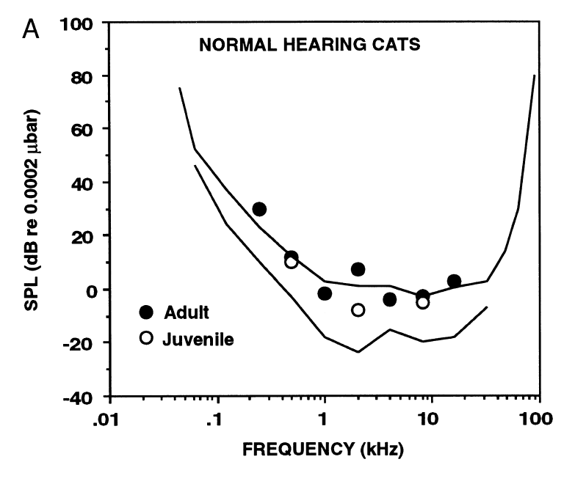
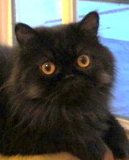
PSYCHO
Pitch (Mels)
Loudness (Sones)
PHYSICS
Frequency (Hertz)
Amplitude (Decibels)

Slide 2
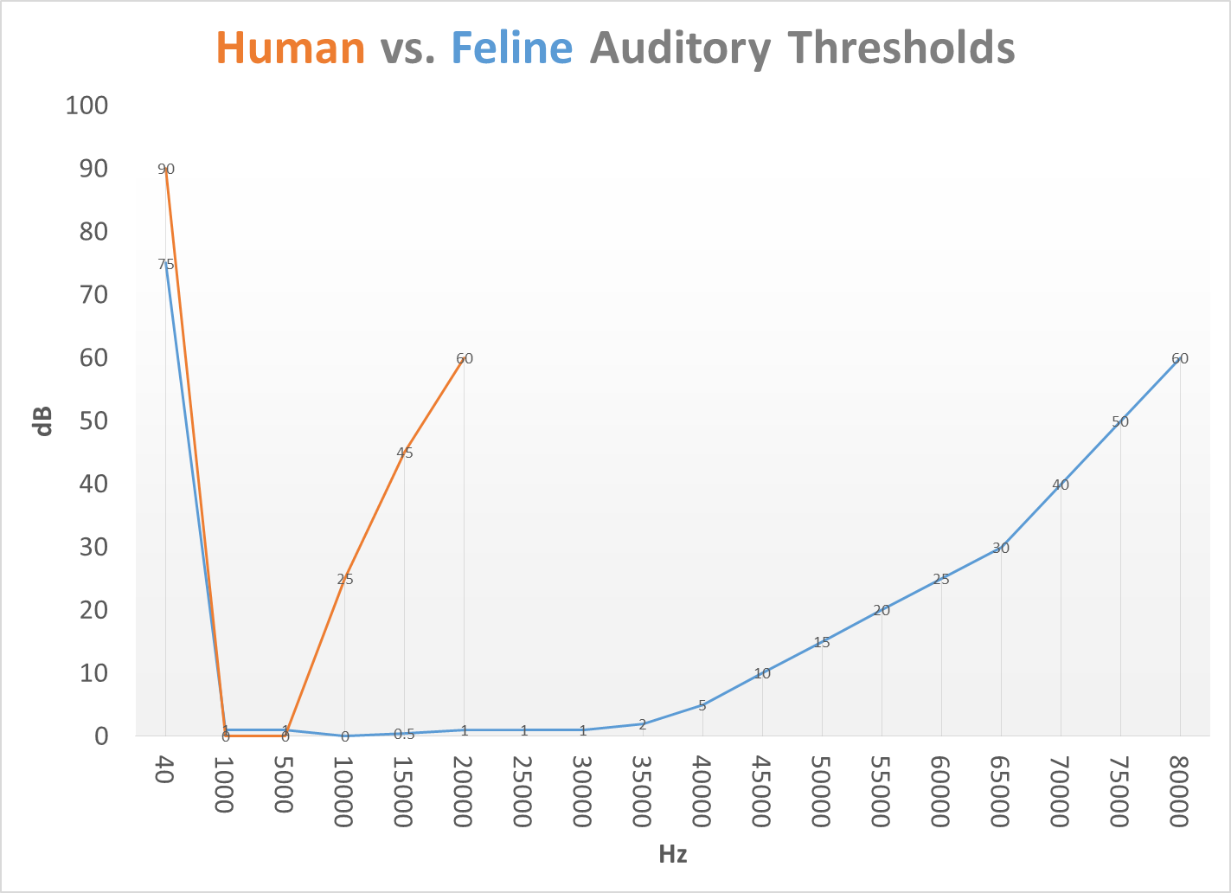

Slide 3
PSYCHO
Pitch (Mels)
Loudness (Sones)
PHYSICS
Frequency (Hertz)
Amplitude (Decibels)
If a tree falls in the forest and no one is there to hear it, will it make a sound?
Human Psychoacoustics shows ‘tuning’
for frequencies of speech

Slide 4
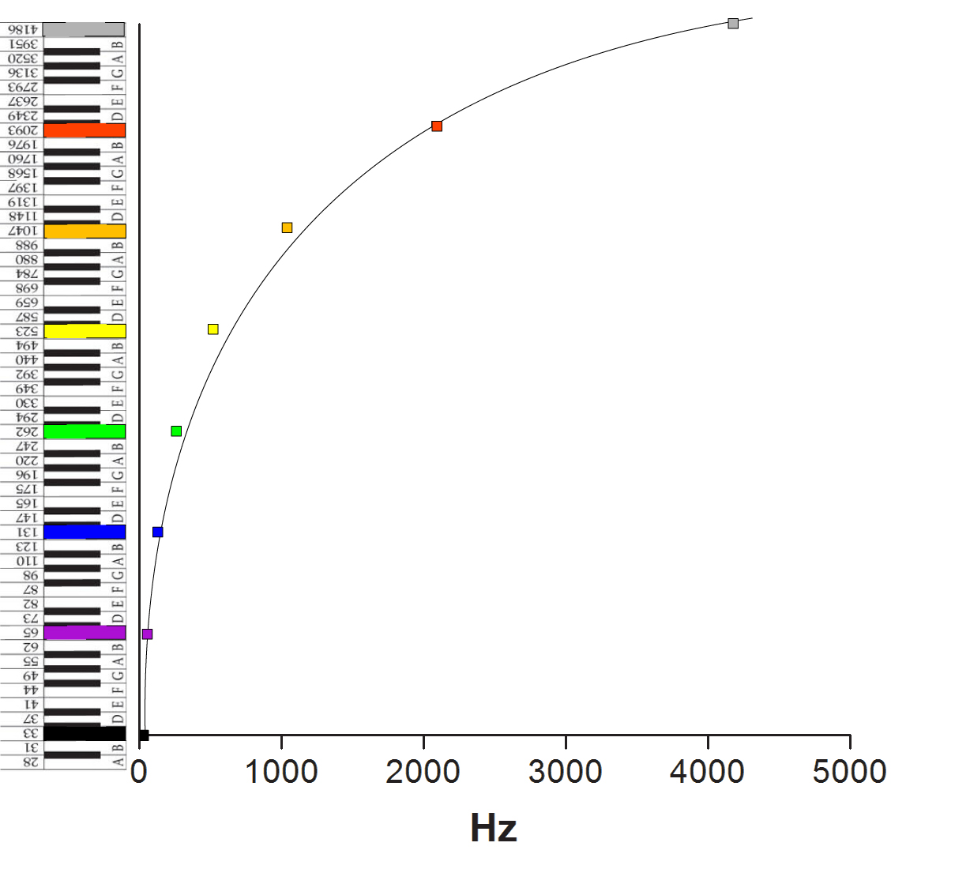
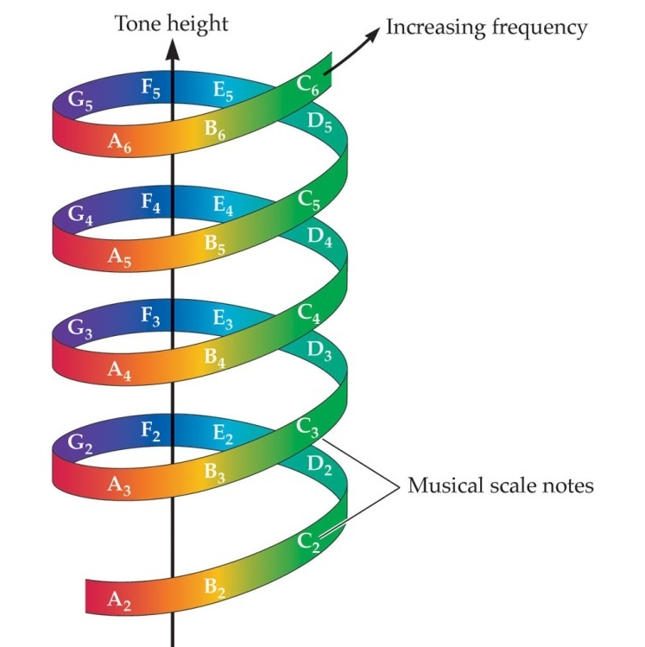

Slide 5
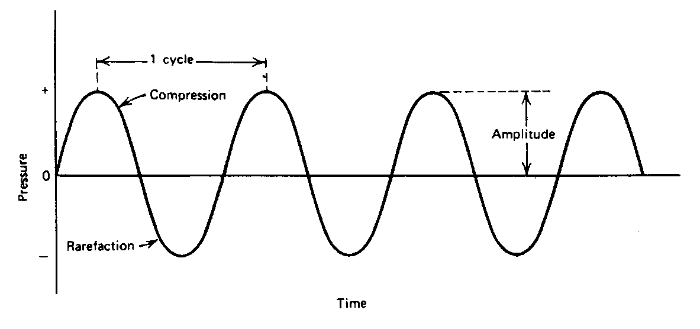
Simple Sounds
(A Pure Tone)
Air
What do ‘speakers’ do?

Slide 6
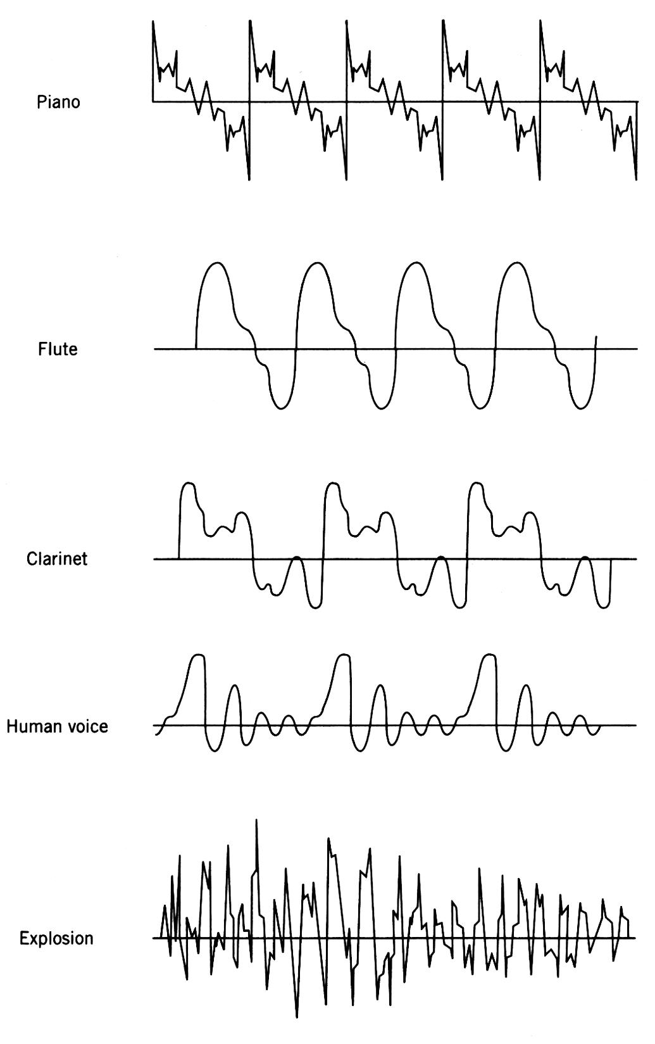
Complex Sounds

Slide 7

Complex Sounds

Slide 8
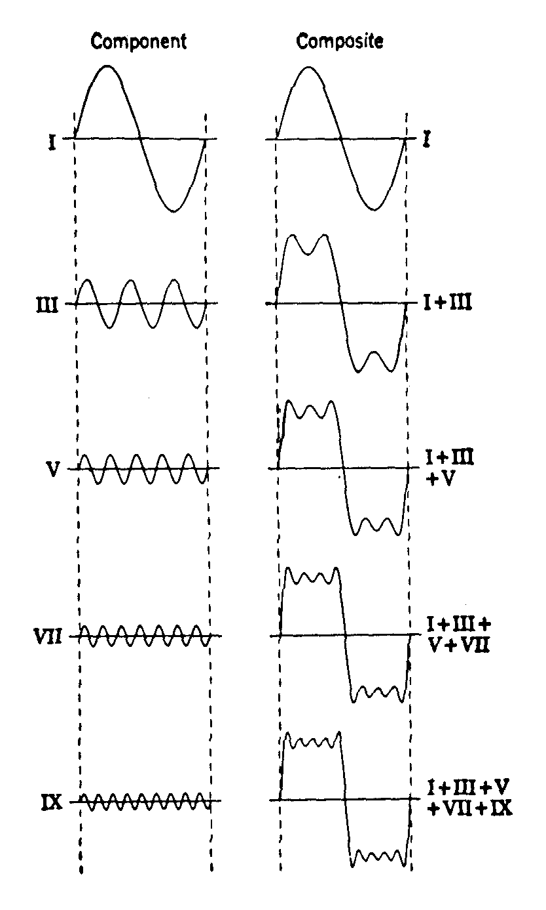
Fourier Analysis
Most Complex Sounds Are Composites of Multiple ‘Simple’ Frequencies
  Fundamentals and Harmonics
Sound Complexity: Perceived ‘psychologically’ as TIMBRE (sound quality). Timbre is a function of the number, intensity, and duration of harmonic frequencies associated with a complex sound
‘simple’ sound wave
‘complex’ sound wave

Slide 9
Fundamental (pitch)
Fourier Analysis of a
Complex Sound Wave
Harmonics (timbre)
Is there an easier way to see this?
=
+
+
+
+

Slide 10
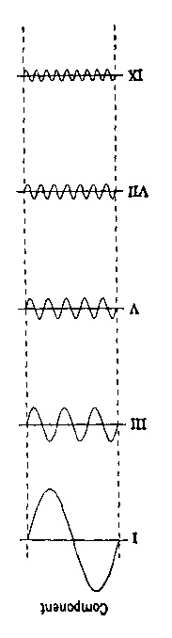
Fourier Analysis
Frequency Spectrogram
(linear scale)
2500 Hz
Trumpet
4
2000 Hz
3
kHz
2
1500 Hz
1
0
1000 Hz
Time
500 Hz

Slide 11
Fourier Analysis
Frequency Spectrogram
(linear scale)
Flute
4
1000 Hz
3
kHz
2
500 Hz
1
0
Time
Are You Ready For Some. . .

Slide 12
+
+
+
+
=
Fourier Synthesis: 5 values encode the waveform (high quality)
Requires multi-voice (multi-frequency) synthesizer
In this example, a ‘5-voice’ synthesizer would be needed
Low sample rate
Med sample rate
=
or
Digital (CD) Audio: 2 values encode the waveform (very low quality)
18 values encode the waveform (med quality)

Slide 13
+
+
+
+
=
Fourier Synthesis: Modeling an ‘acoustic’ instrument
However, since each frequency is produced independently, harmonic frequencies can be manipulated directly to create completely new timbres not possible with acoustic instruments: the birth of techno!
Amplitude modulation of high freq harmonic
+
+
+
+
=

Slide 14
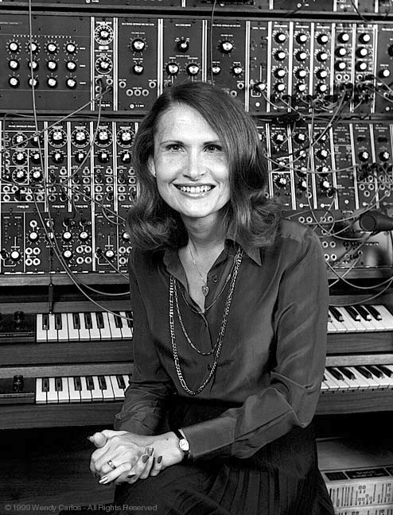
Fourier Analysis
Frequency Spectrogram
2500 Hz
Synth
4
2000 Hz
3
kHz
2
1500 Hz
1
0
1000 Hz
Time
500 Hz

Slide 15
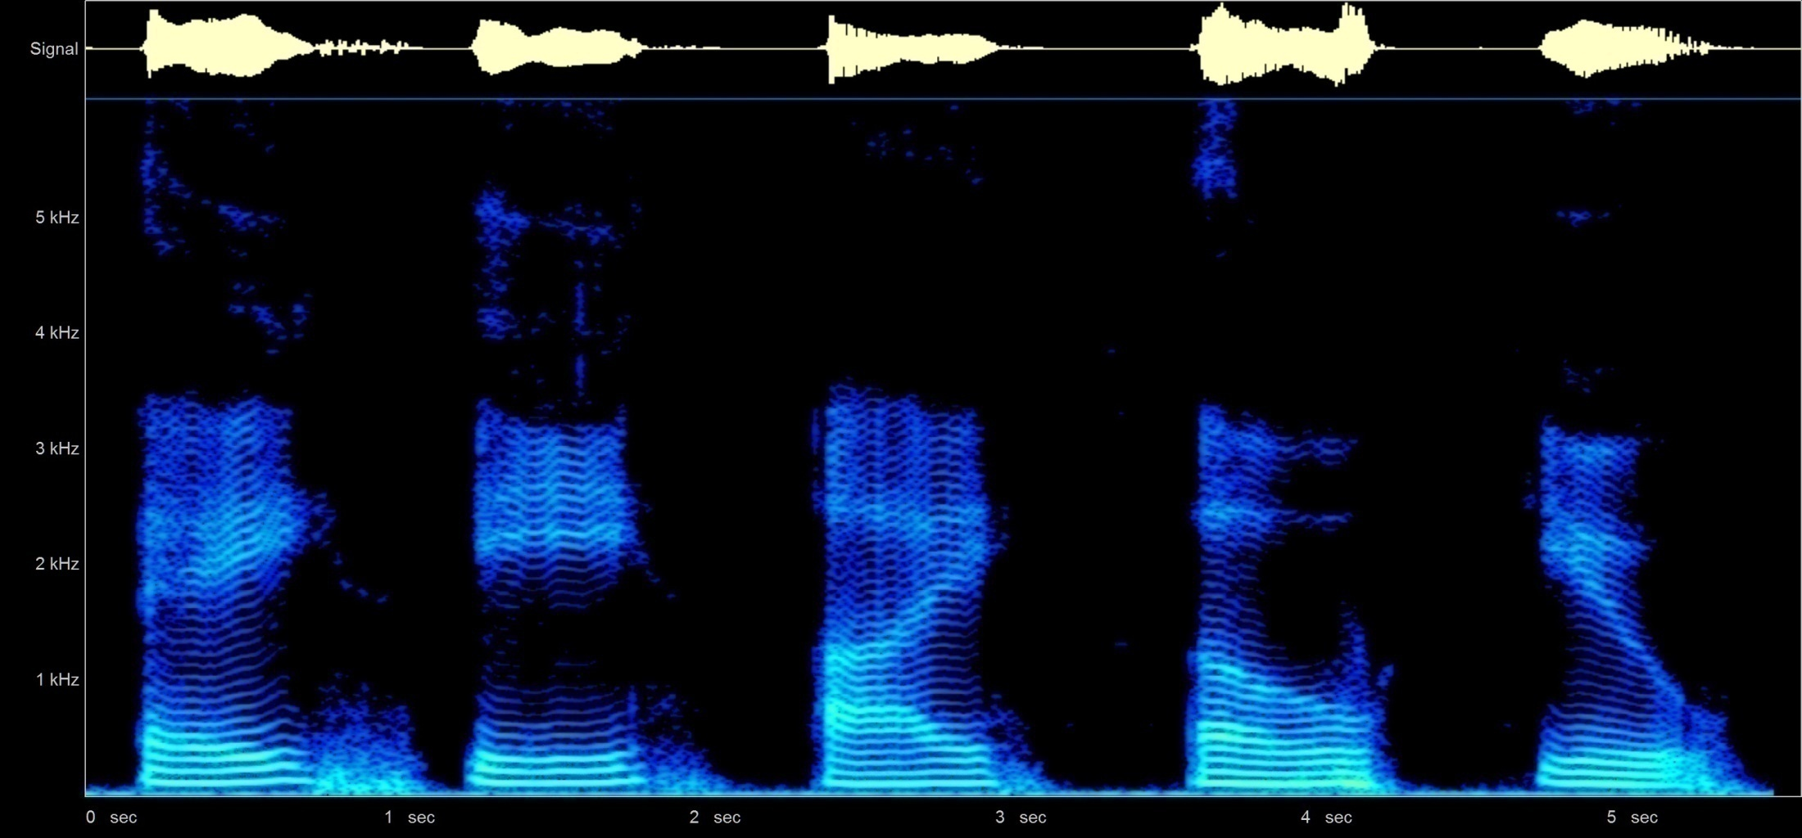
Guess who else does amplitude modulation of harmonics?
The ‘raw’ complex sound waves for each vowel sound
A E I O U
Fourier Analysis breaks each complex sound wave into individual frequency components

